Slide 1
Lecture 7: Model Selection and Regularization

Slide 2
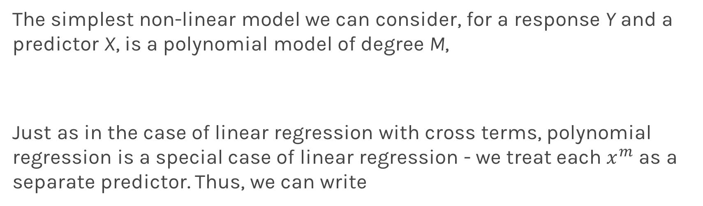
Polynomial Regression
The simplest non-linear model we can consider, for a response Y and a predictor X, is a polynomial model of degree M,
Just as in the case of linear regression with cross terms, polynomial regression is a special case of linear regression - we treat each $x^{m}$ as a separate predictor. Thus, we can write

Slide 3
Polynomial Regression
ADD AN EXAMPLE

Slide 4
Lecture Outline
Overfitting
Bias vs Variance
Regularization: LASSO and Ridge
Regularization Methods: A Comparison

Slide 5
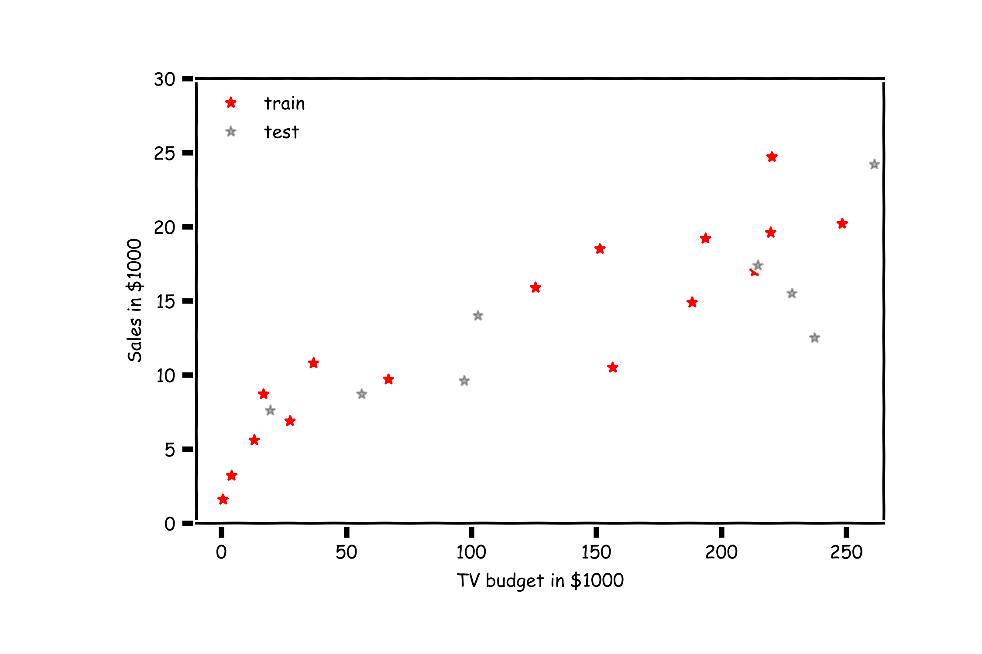
Overfitting

Slide 6
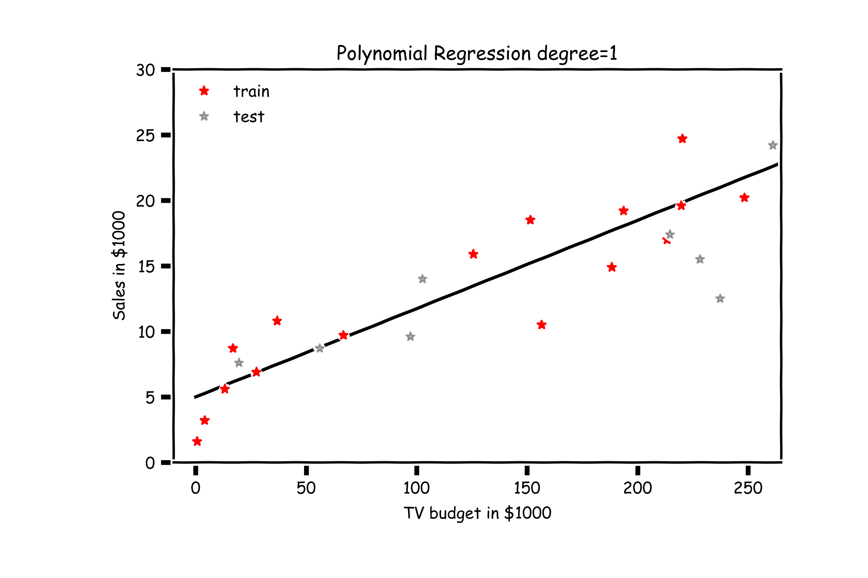
Overfitting

Slide 7
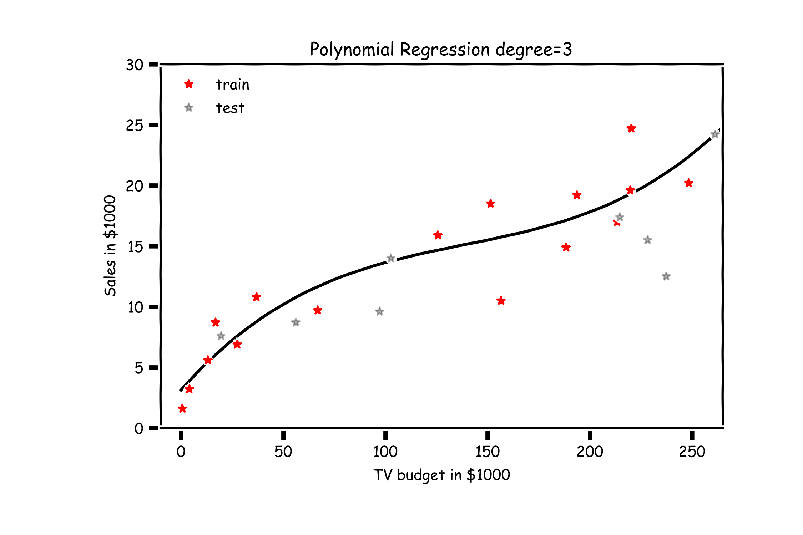
Overfitting

Slide 8
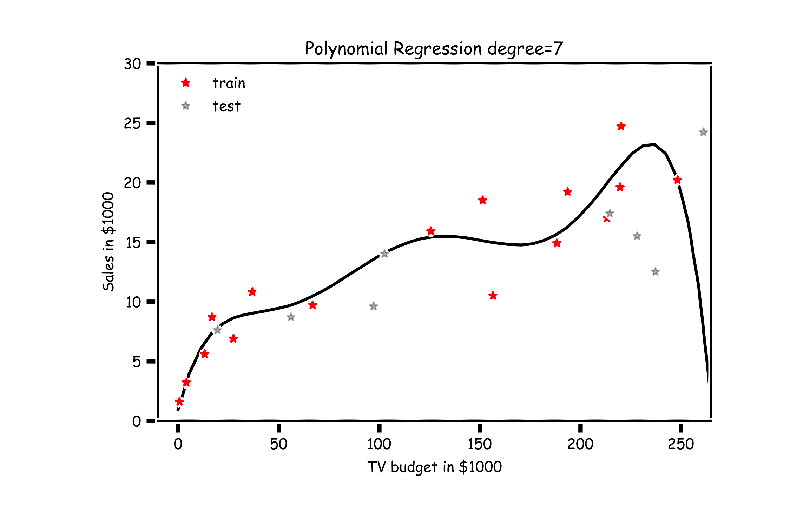
Overfitting

Slide 9
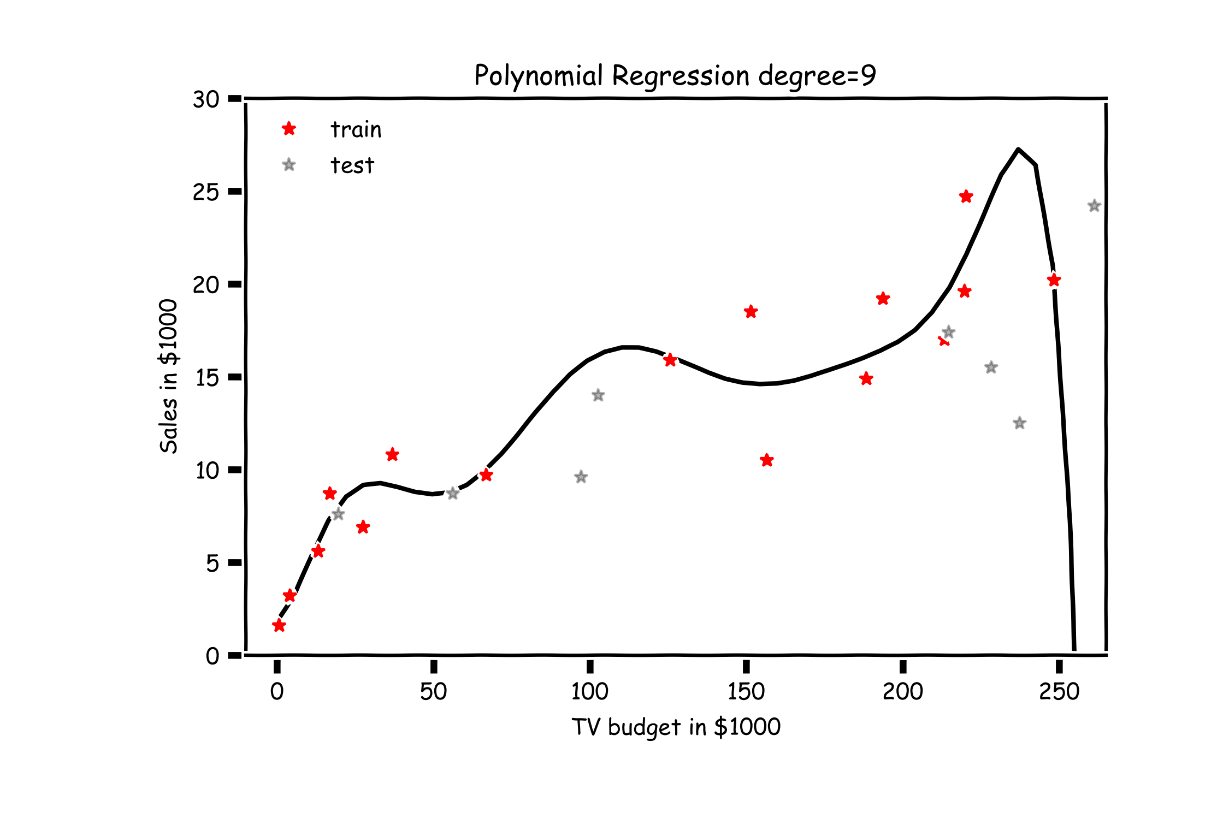
Overfitting

Slide 10
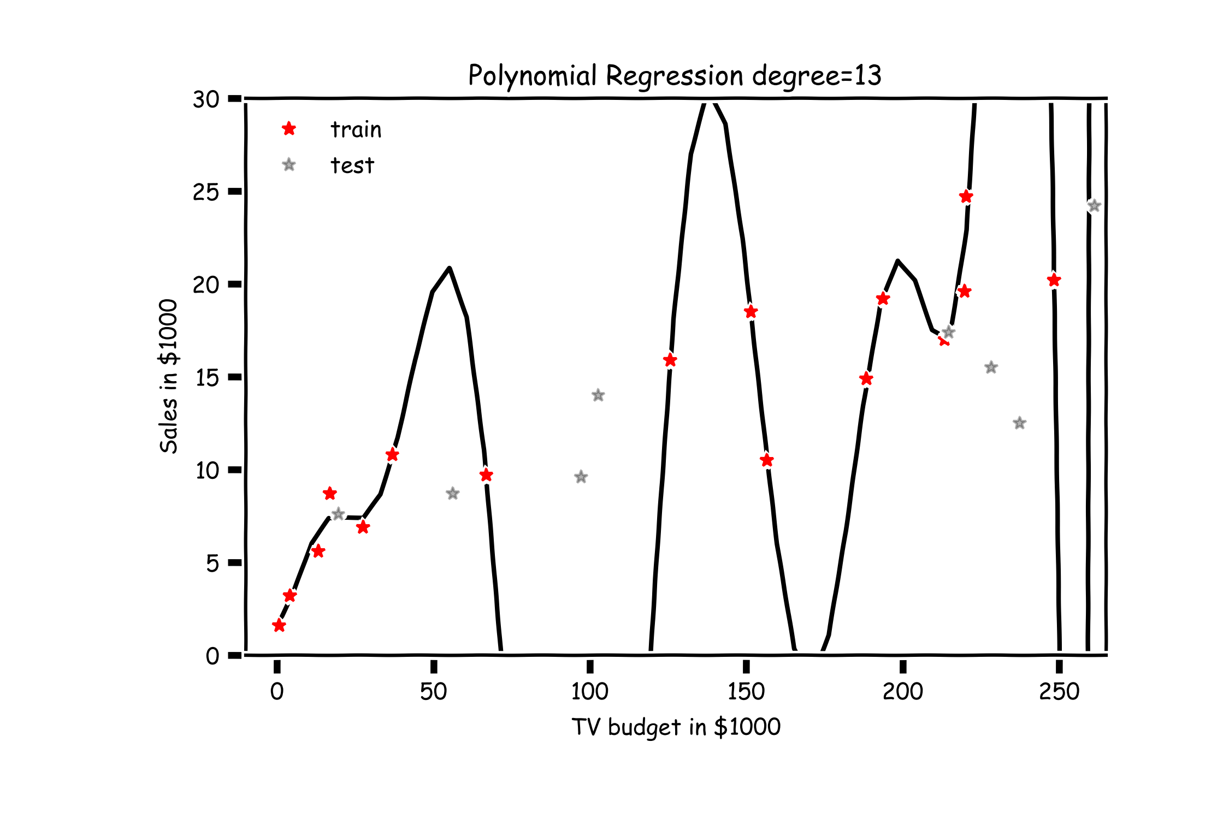
Overfitting

Slide 11
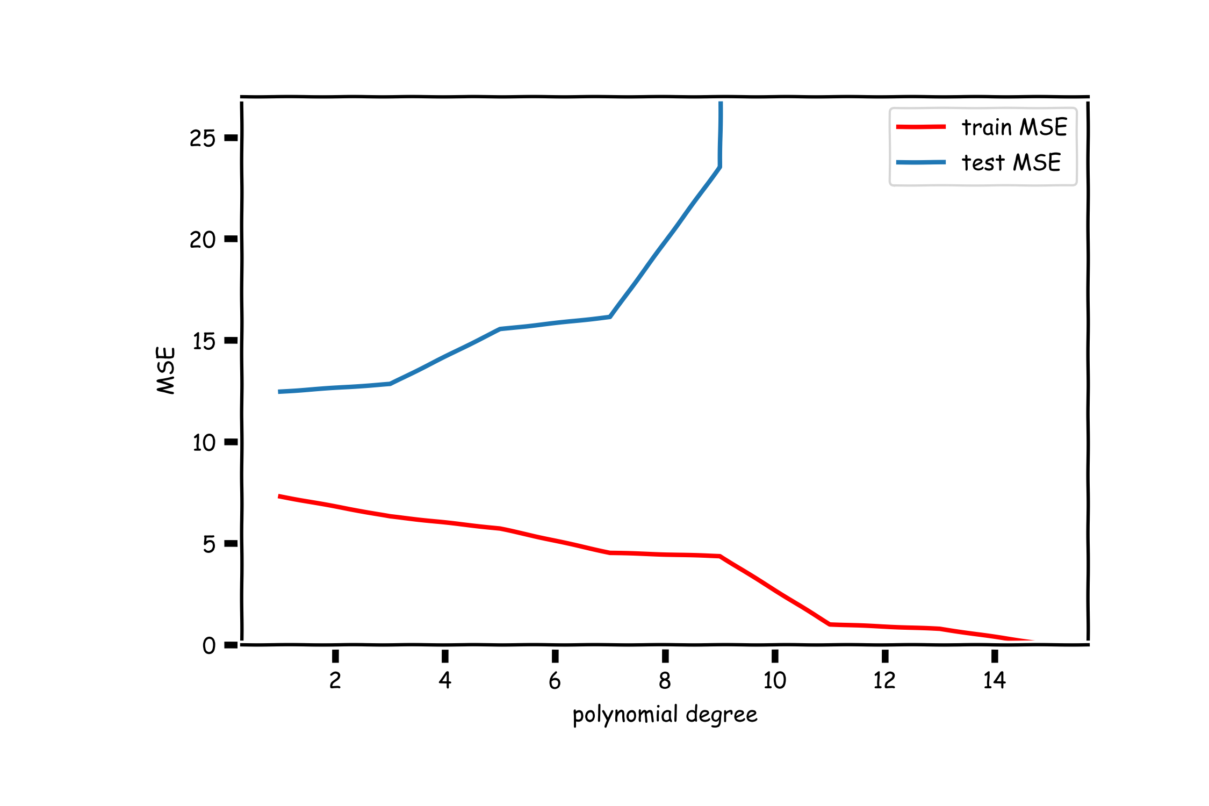
Validation

Slide 12
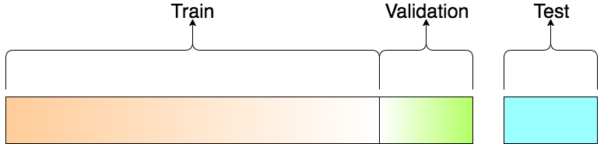
Train-Validation-Test
Question:
How would you report the performance of the model?
R2_test = 0.52
R2_train(degree=1) = 0.83

Slide 13
Model Selection
Model selection is the application of a principled method to determine the complexity of the model, e.g. choosing a subset of predictors, choosing the degree of the polynomial model etc.
A strong motivation for performing model selection is to avoid overfitting, which we saw can happen when:
there are too many predictors:
the feature space has high dimensionality
the polynomial degree is too high
too many cross terms are considered
the coefficients values are too extreme (we have not seen this yet)

Slide 14
Stepwise Variable Selection and Cross Validation
Selecting optimal subsets of predictors (including choosing the degree of polynomial models) through:
stepwise variable selection - iteratively building an optimal subset of predictors by optimizing a fixed model evaluation metric each time,
validation - selecting an optimal model by evaluating each model on validation set.
We will also address the issue of discouraging extreme values in model parameters later.

Slide 15
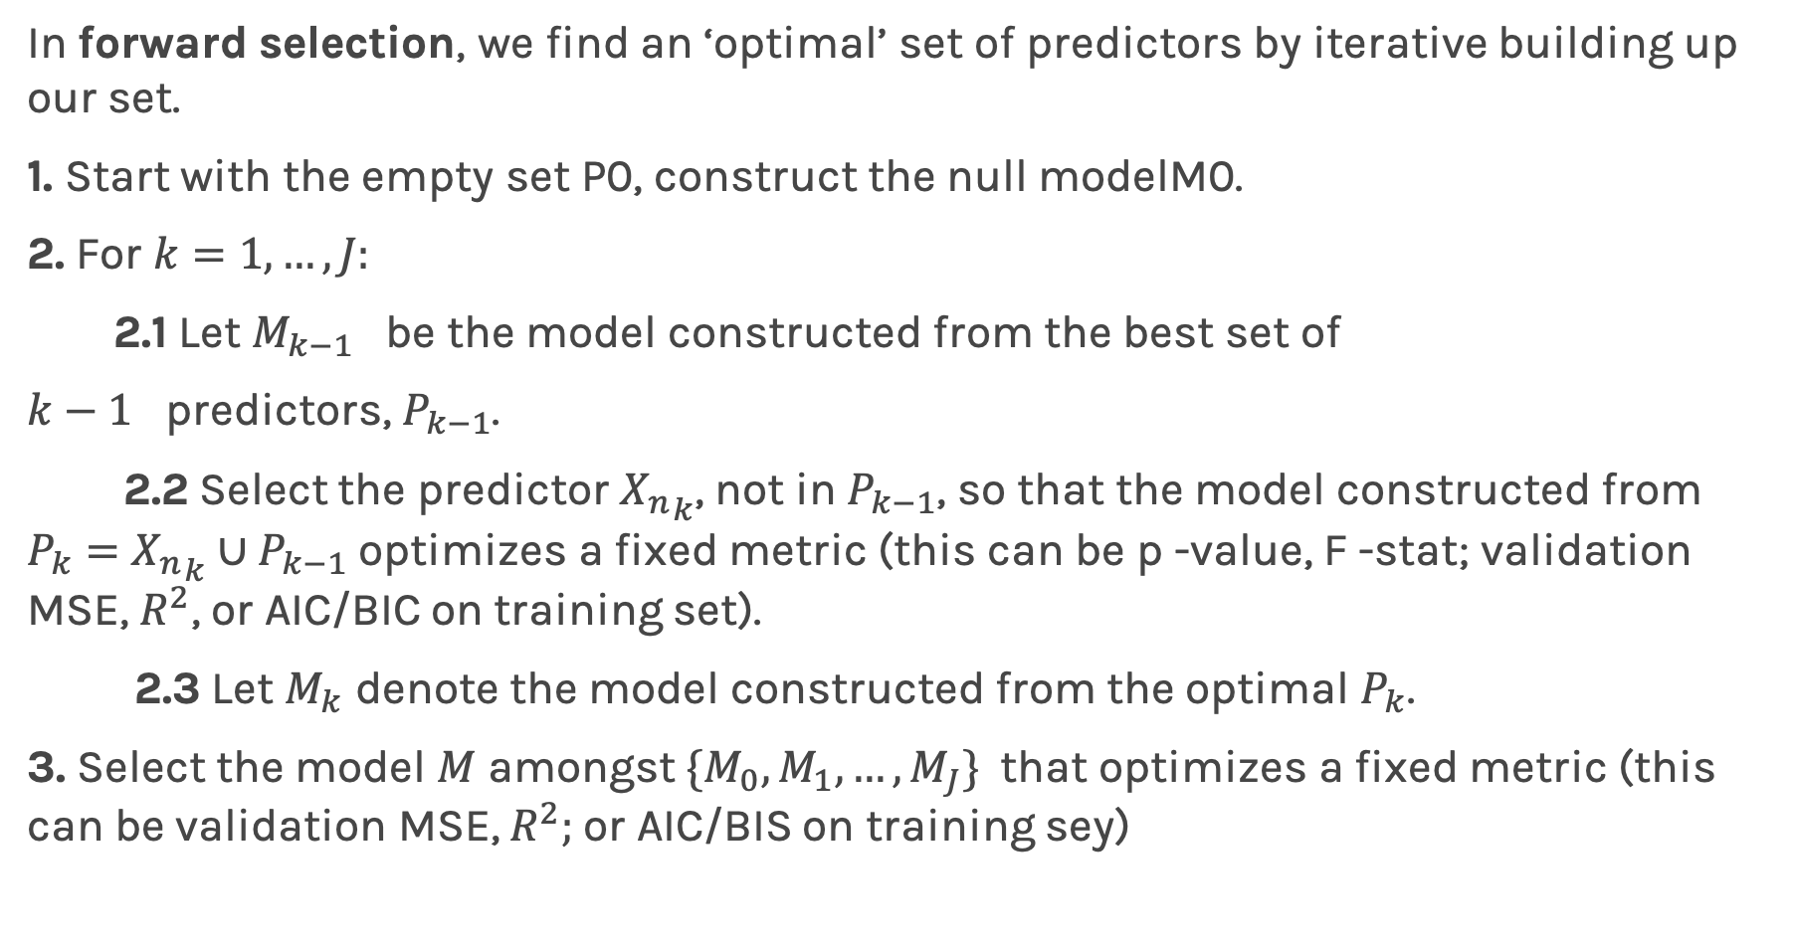
Stepwise Variable Selection: Forward method
In forward selection, we find an ‘optimal’ set of predictors by iterative building up our set.
1. Start with the empty set P0, construct the null modelM0.
2. For $k=1,…, J:$
2.1 Let $M_{k−1}$ be the model constructed from the best set of
$k−1$ predictors, $P_{k−1}$.
2.2 Select the predictor ${X_{n}}_{k}$, not in $P_{k−1}$, so that the model constructed from $P_{k}=$ ${X_{n}}_{k}∪P_{k−1}$ optimizes a fixed metric (this can be p -value, F -stat; validation MSE, $R^{2}$, or AIC/BIC on training set).
2.3 Let $M_{k}$ denote the model constructed from the optimal $P_{k}$.
3. Select the model $M$ amongst $\{M_{0}, M_{1},…, M_{J}\}$that optimizes a fixed metric (this can be validation MSE, $R^{2};$or AIC/BIS on training sey)

Slide 16
Stepwise Variable Selection Computational Complexity
How many models did we evaluate?
1st step, J Models
2nd step, J-1 Models (add 1 predictor out of J-1 possible)
3rd step, J-2 Models (add 1 predictor out of J-2 possible)
…

Slide 17
Cross Validation

Slide 18
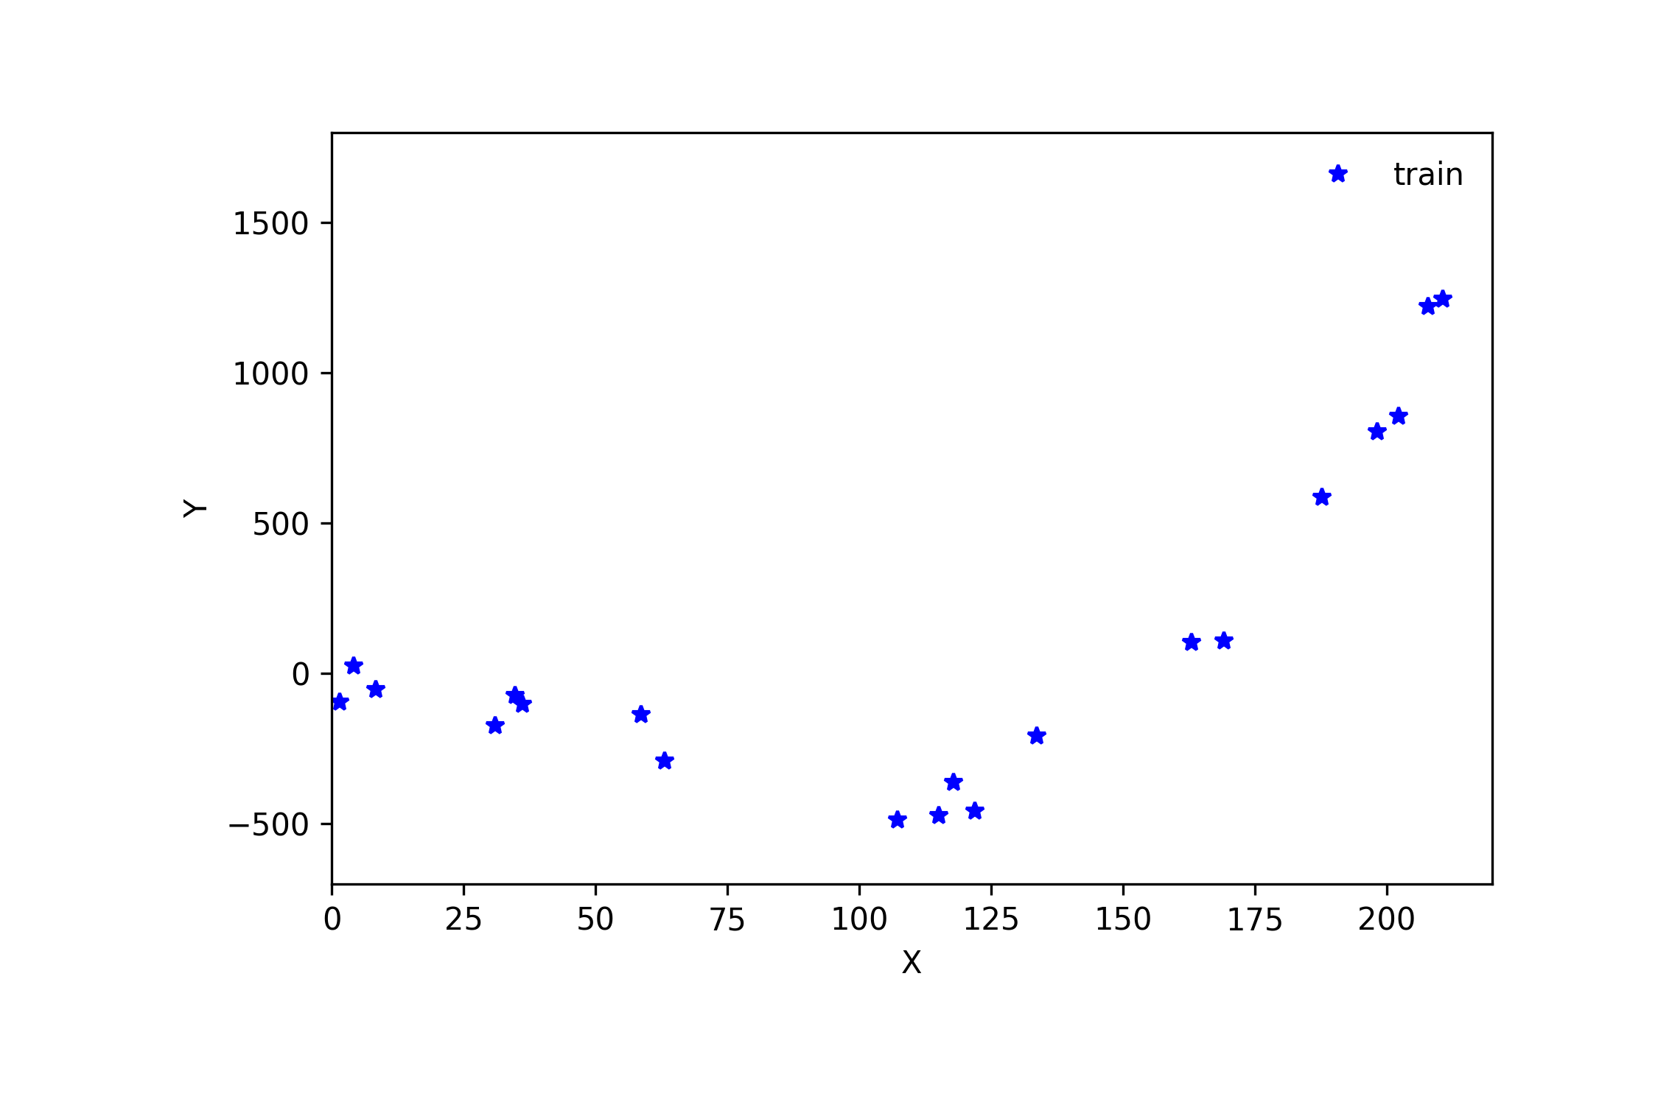
Cross Validation

Slide 19
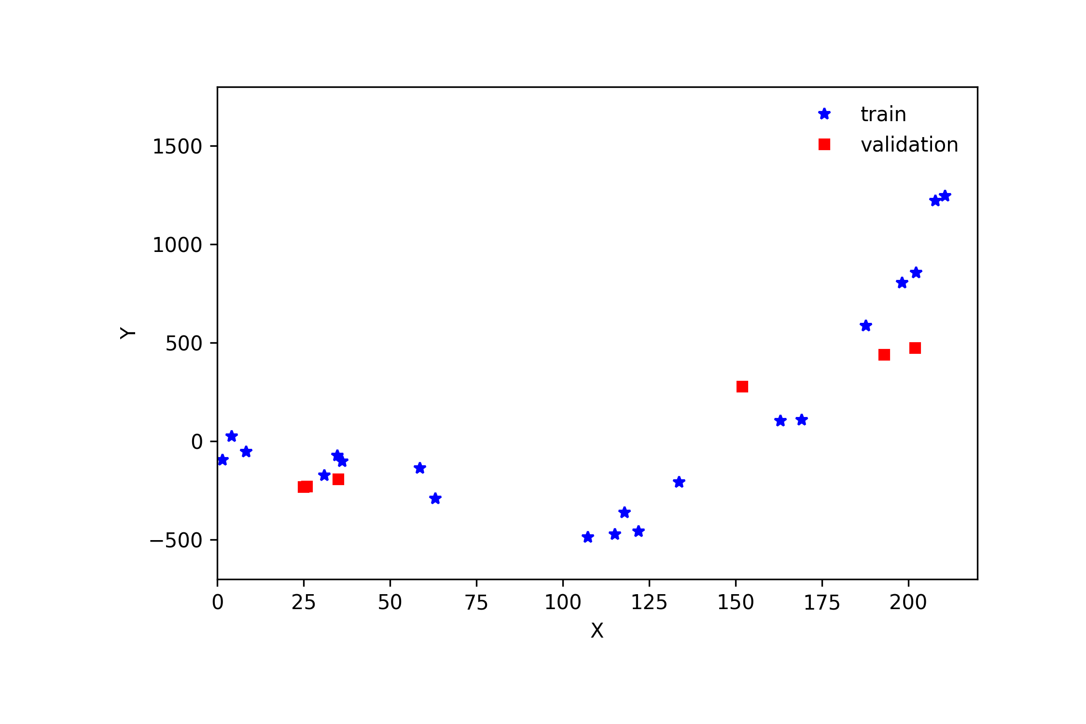
Cross Validation

Slide 20
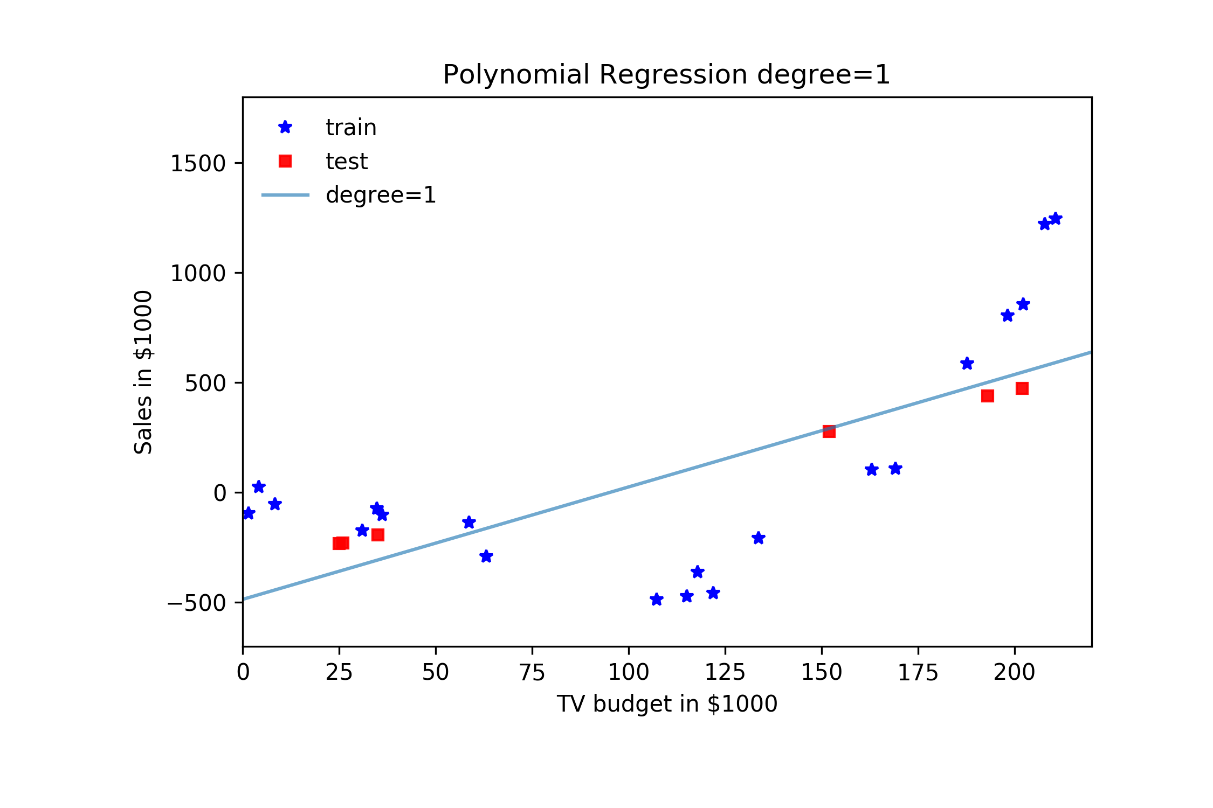
Cross Validation

Slide 21
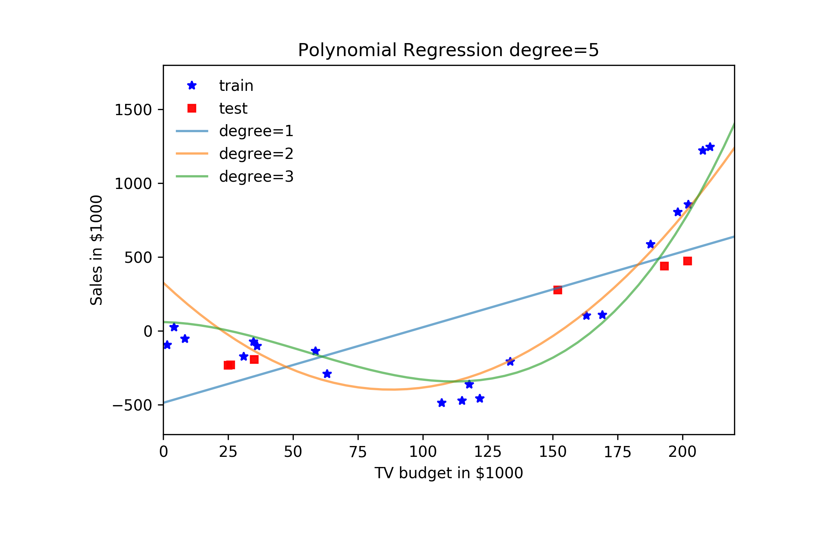
Cross Validation

Slide 22
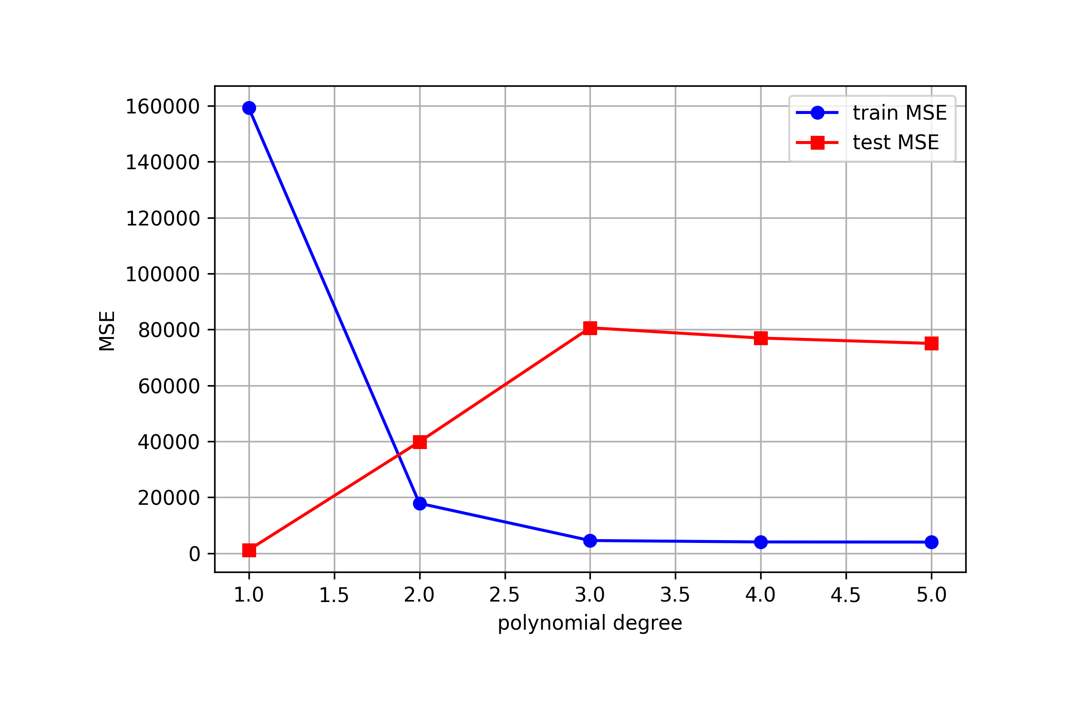
Validation

Slide 23
Cross Validation: Motivation
Using a single validation set to select amongst multiple models can be problematic - there is the possibility of overfitting to the validation set.
One solution to the problems raised by using a single validation set is to evaluate each model on multiple validation sets and average the validation performance.
One can randomly split the training set into training and validation multiple times but randomly creating these sets can create the scenario where important features of the data never appear in our random draws.

Slide 24
Cross Validation

Slide 25
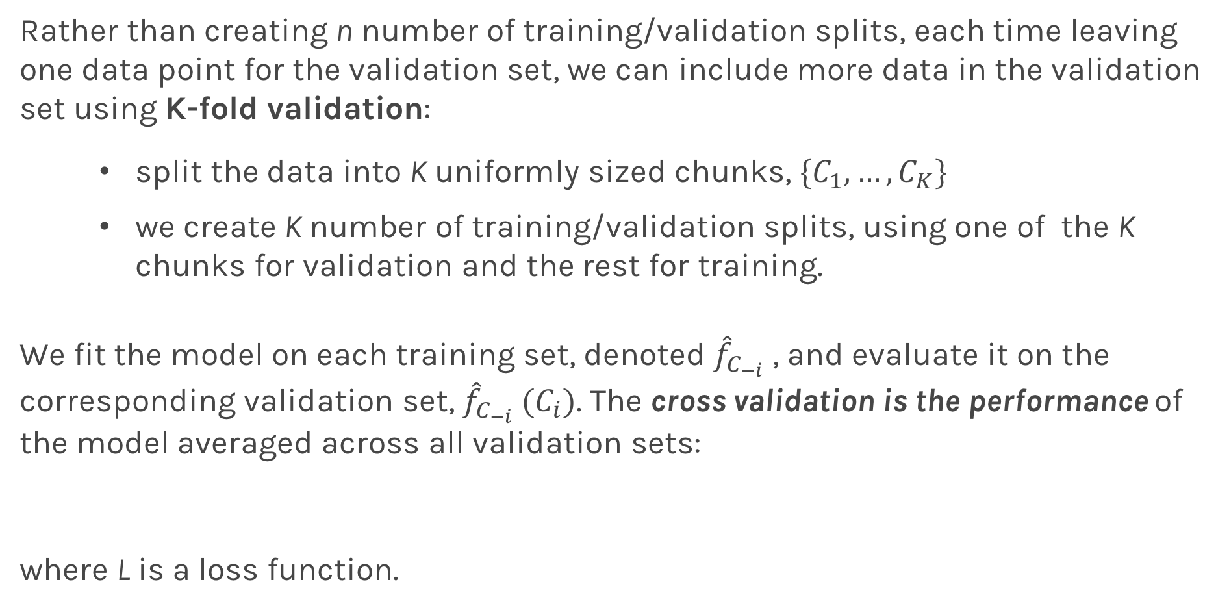
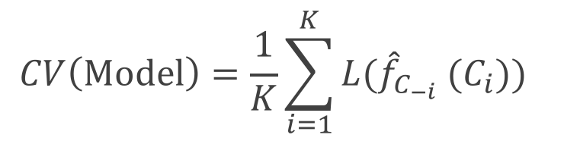
K-Fold Cross Validation
Rather than creating n number of training/validation splits, each time leaving one data point for the validation set, we can include more data in the validation set using K-fold validation:
split the data into K uniformly sized chunks, $\{C_{1},…,C_{K}\}$
we create K number of training/validation splits, using one of the K chunks for validation and the rest for training.
We fit the model on each training set, denoted ${\hat{f}}_{C_{−i}}$ , and evaluate it on the corresponding validation set, ${\hat{f}}_{C_{−i}} (C_{i})$. The cross validation is the performance of the model averaged across all validation sets:
where L is a loss function.
$$CV\left(Model\right)=\frac{1}{K}\sum_{i=1}^{K}{{L(\hat{f}}_{C_{−i}} (C_{i})\text{)} }$$

Slide 26
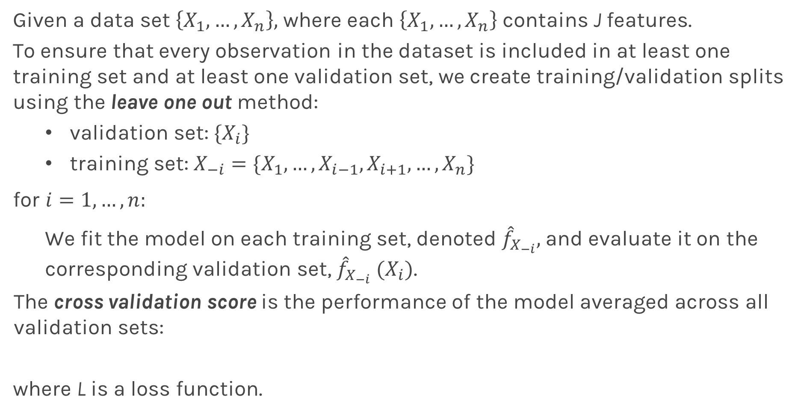
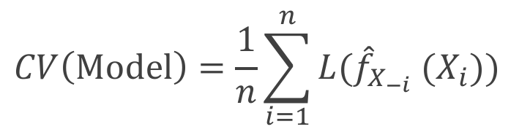
Leave-One-Out
Given a data set $\left\{X_{1},…,X_{n}\right\},$ where each $\left\{X_{1},…,X_{n}\right\}$ contains J features.
To ensure that every observation in the dataset is included in at least one training set and at least one validation set, we create training/validation splits using the leave one out method:
validation set: ${\{X}_{i}\}$
training set: $X_{−i}=\{X_{1}, …,X_{i−1},X_{i+1}, …, X_{n}\}$
for ${i=1,…,n: }_{}$
We fit the model on each training set, denoted ${\hat{f}}_{X_{−i}},$and evaluate it on the corresponding validation set, ${\hat{f}}_{X_{−i}} (X_{i})$.
The cross validation score is the performance of the model averaged across all validation sets:
where L is a loss function.
$$CV\left(Model\right)=\frac{1}{n}\sum_{i=1}^{n}{{L(\hat{f}}_{X_{−i}} (X_{i})\text{)} }$$

Slide 27
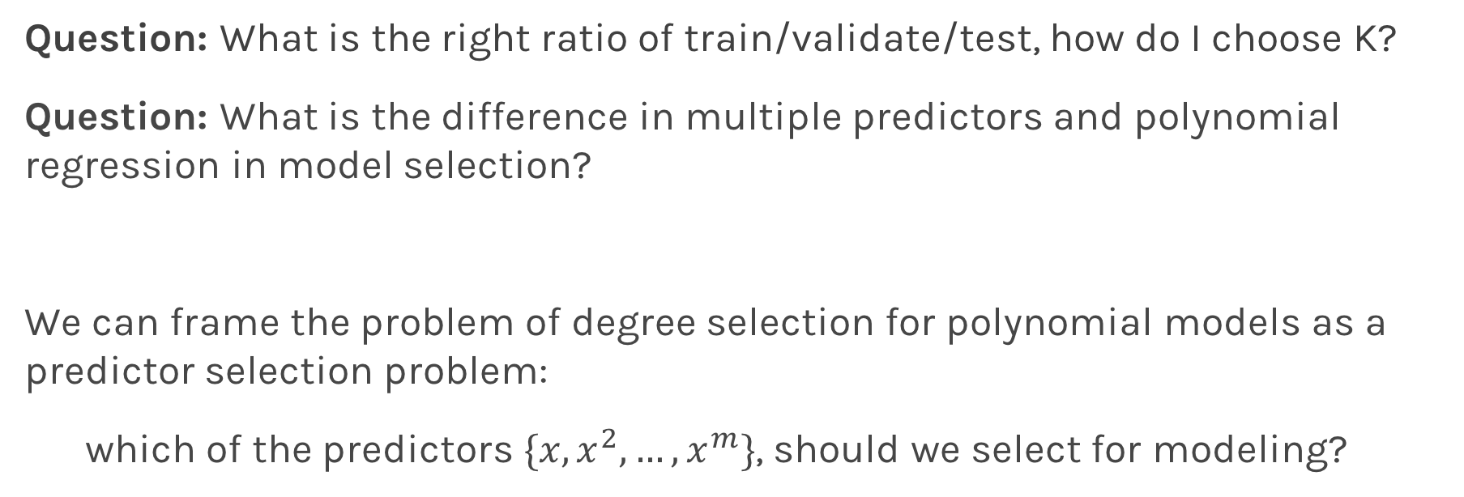
Predictor Selection: Cross Validation
Question: What is the right ratio of train/validate/test, how do I choose K?
Question: What is the difference in multiple predictors and polynomial regression in model selection?
We can frame the problem of degree selection for polynomial models as a predictor selection problem:
which of the predictors $\{x, x^{2},…, x^{m}\}$, should we select for modeling?

Slide 28
kNN Revisited
Recall our first simple, intuitive, non-parametric model for regression - the kNN model. We saw that it is vitally important to select an appropriate k for the data.
If the k is too small then the model is very sensitive to noise (since a new prediction is based on very few observed neighbors), and if the k is too large, the model tends towards making constant predictions.

Slide 29

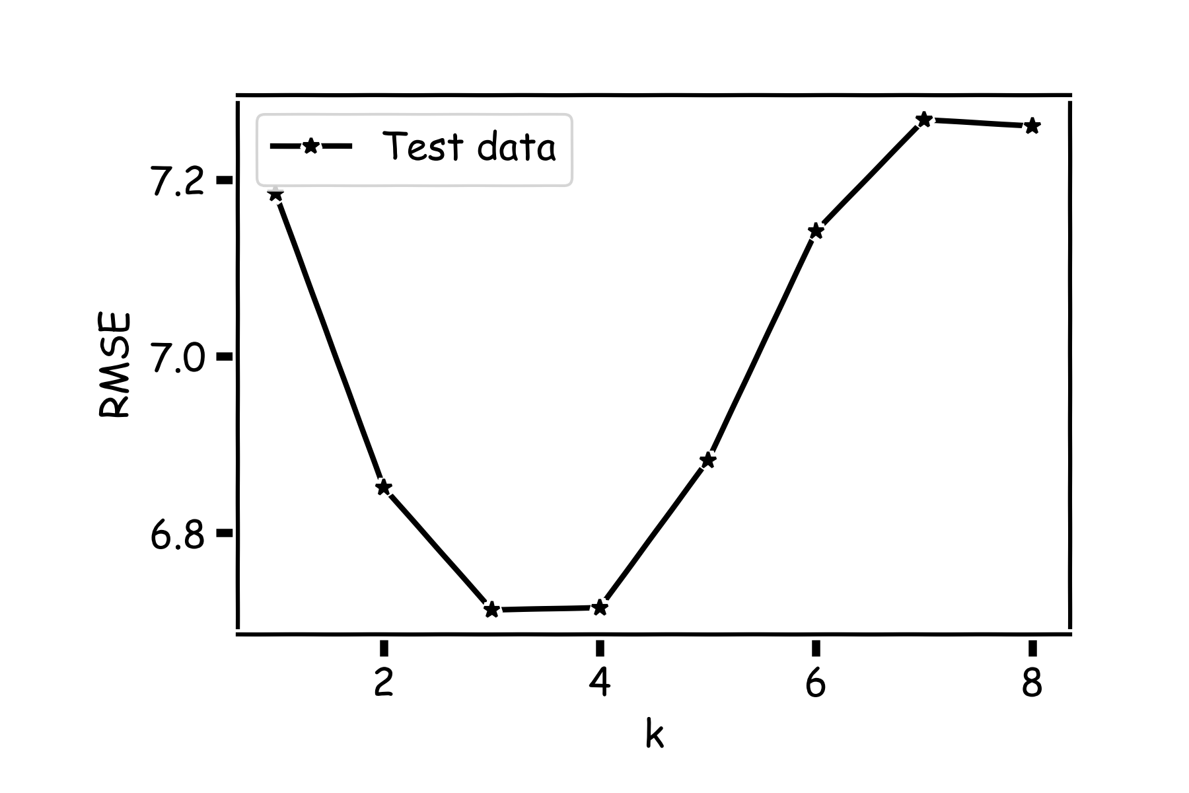
kNN Revisited

Slide 30
kNN Revisited
Recall our first simple, intuitive, non-parametric model for regression - the kNN model. We saw that it is vitally important to select an appropriate k for the data.
If the k is too small then the model is very sensitive to noise (since a new prediction is based on very few observed neighbors), and if the k is too large, the model tends towards making constant predictions.
A principled way to choose k is through K-fold cross validation.

Slide 31
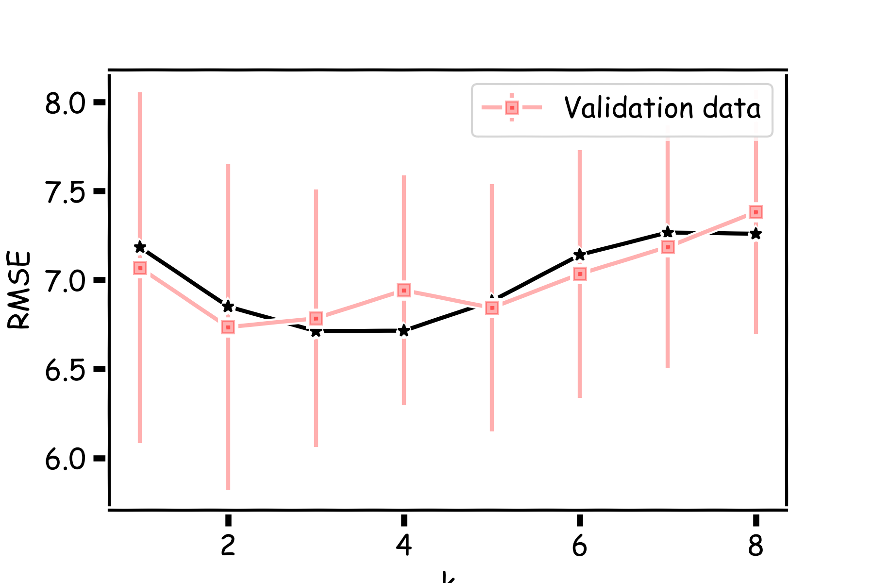
K-fold with k=100

Slide 32
Bias vs Variance

Slide 35
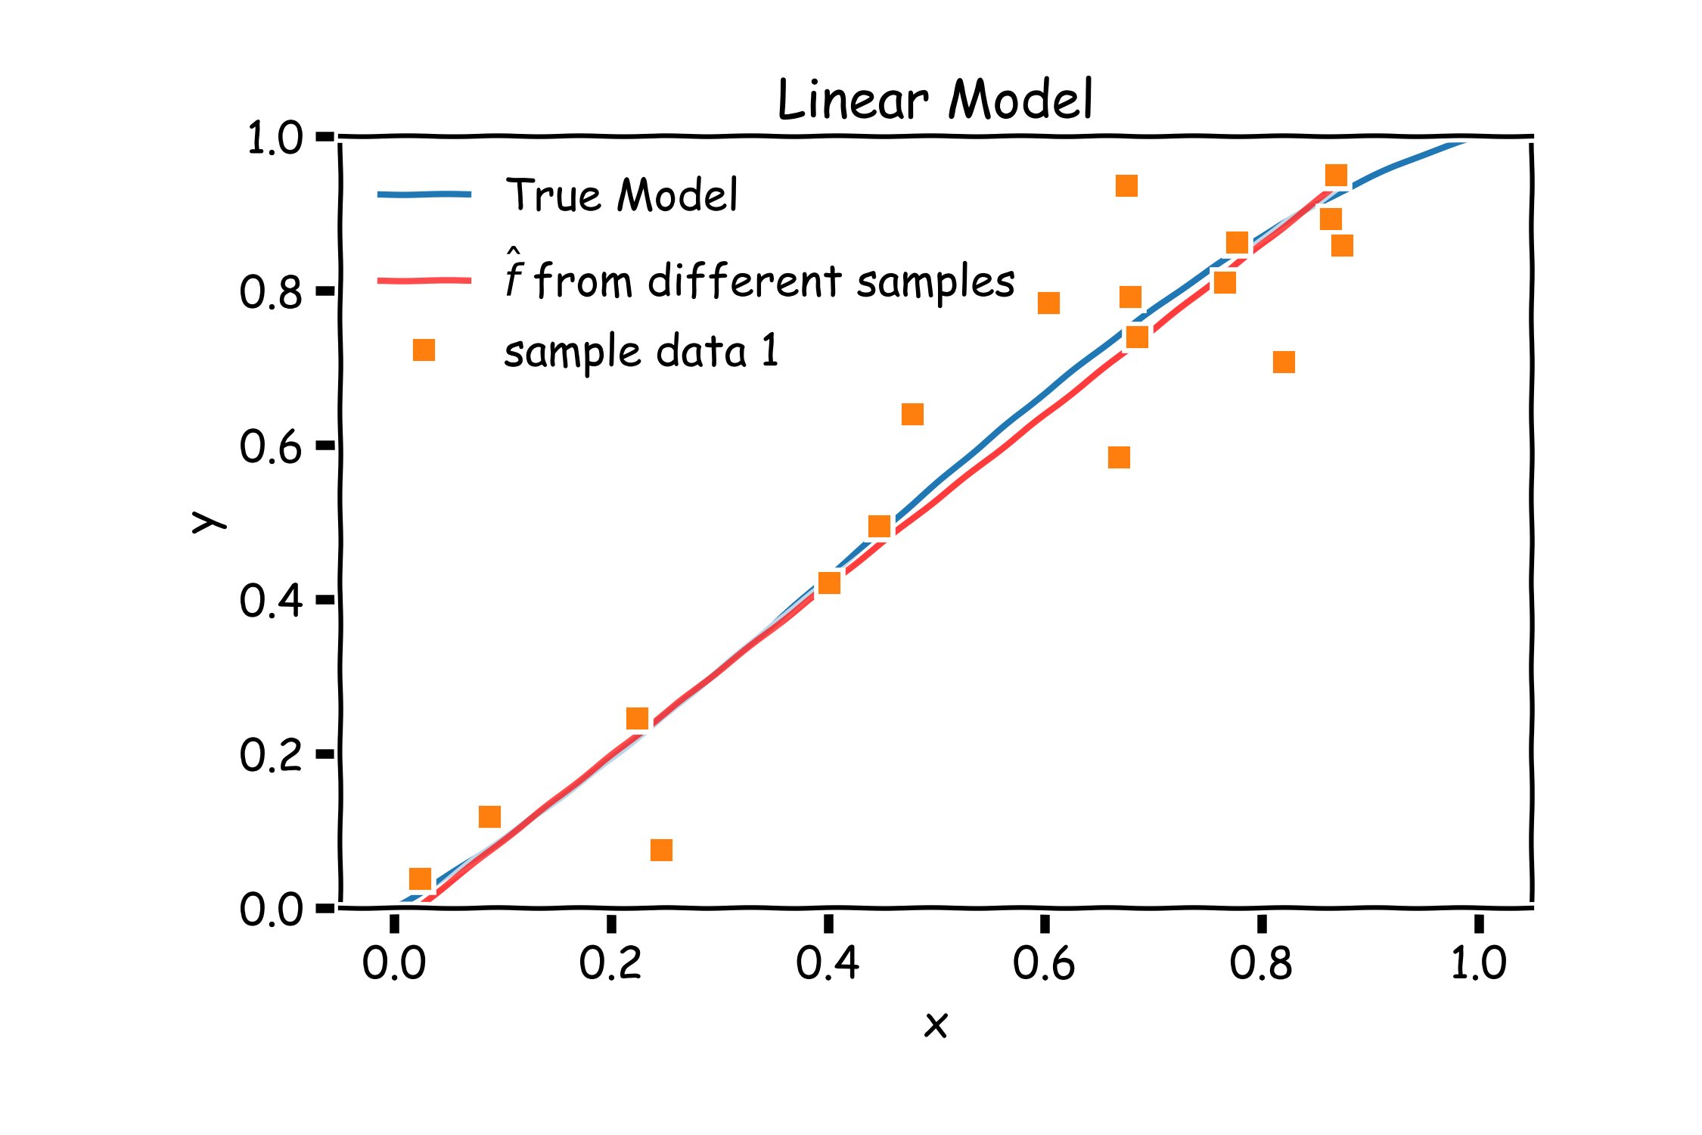
Bias vs Variance

Slide 36
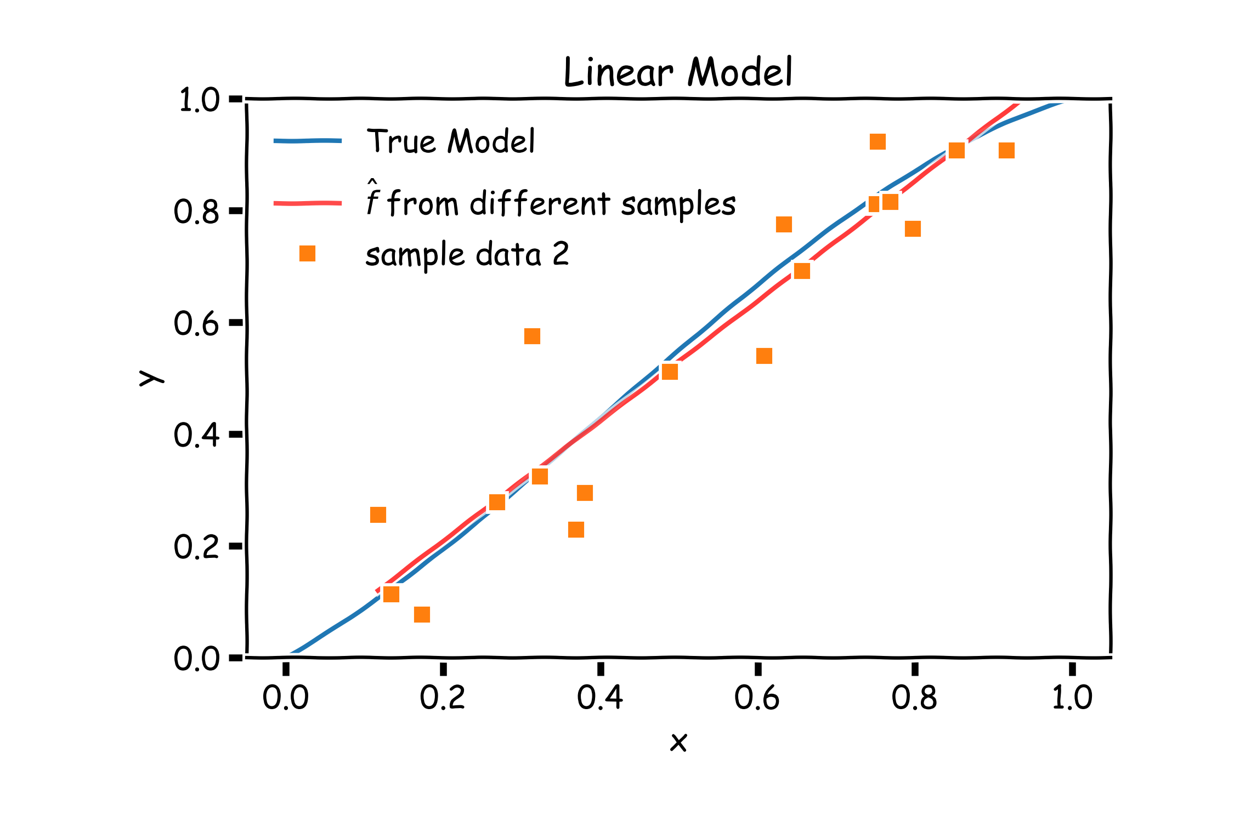
Bias vs Variance

Slide 37
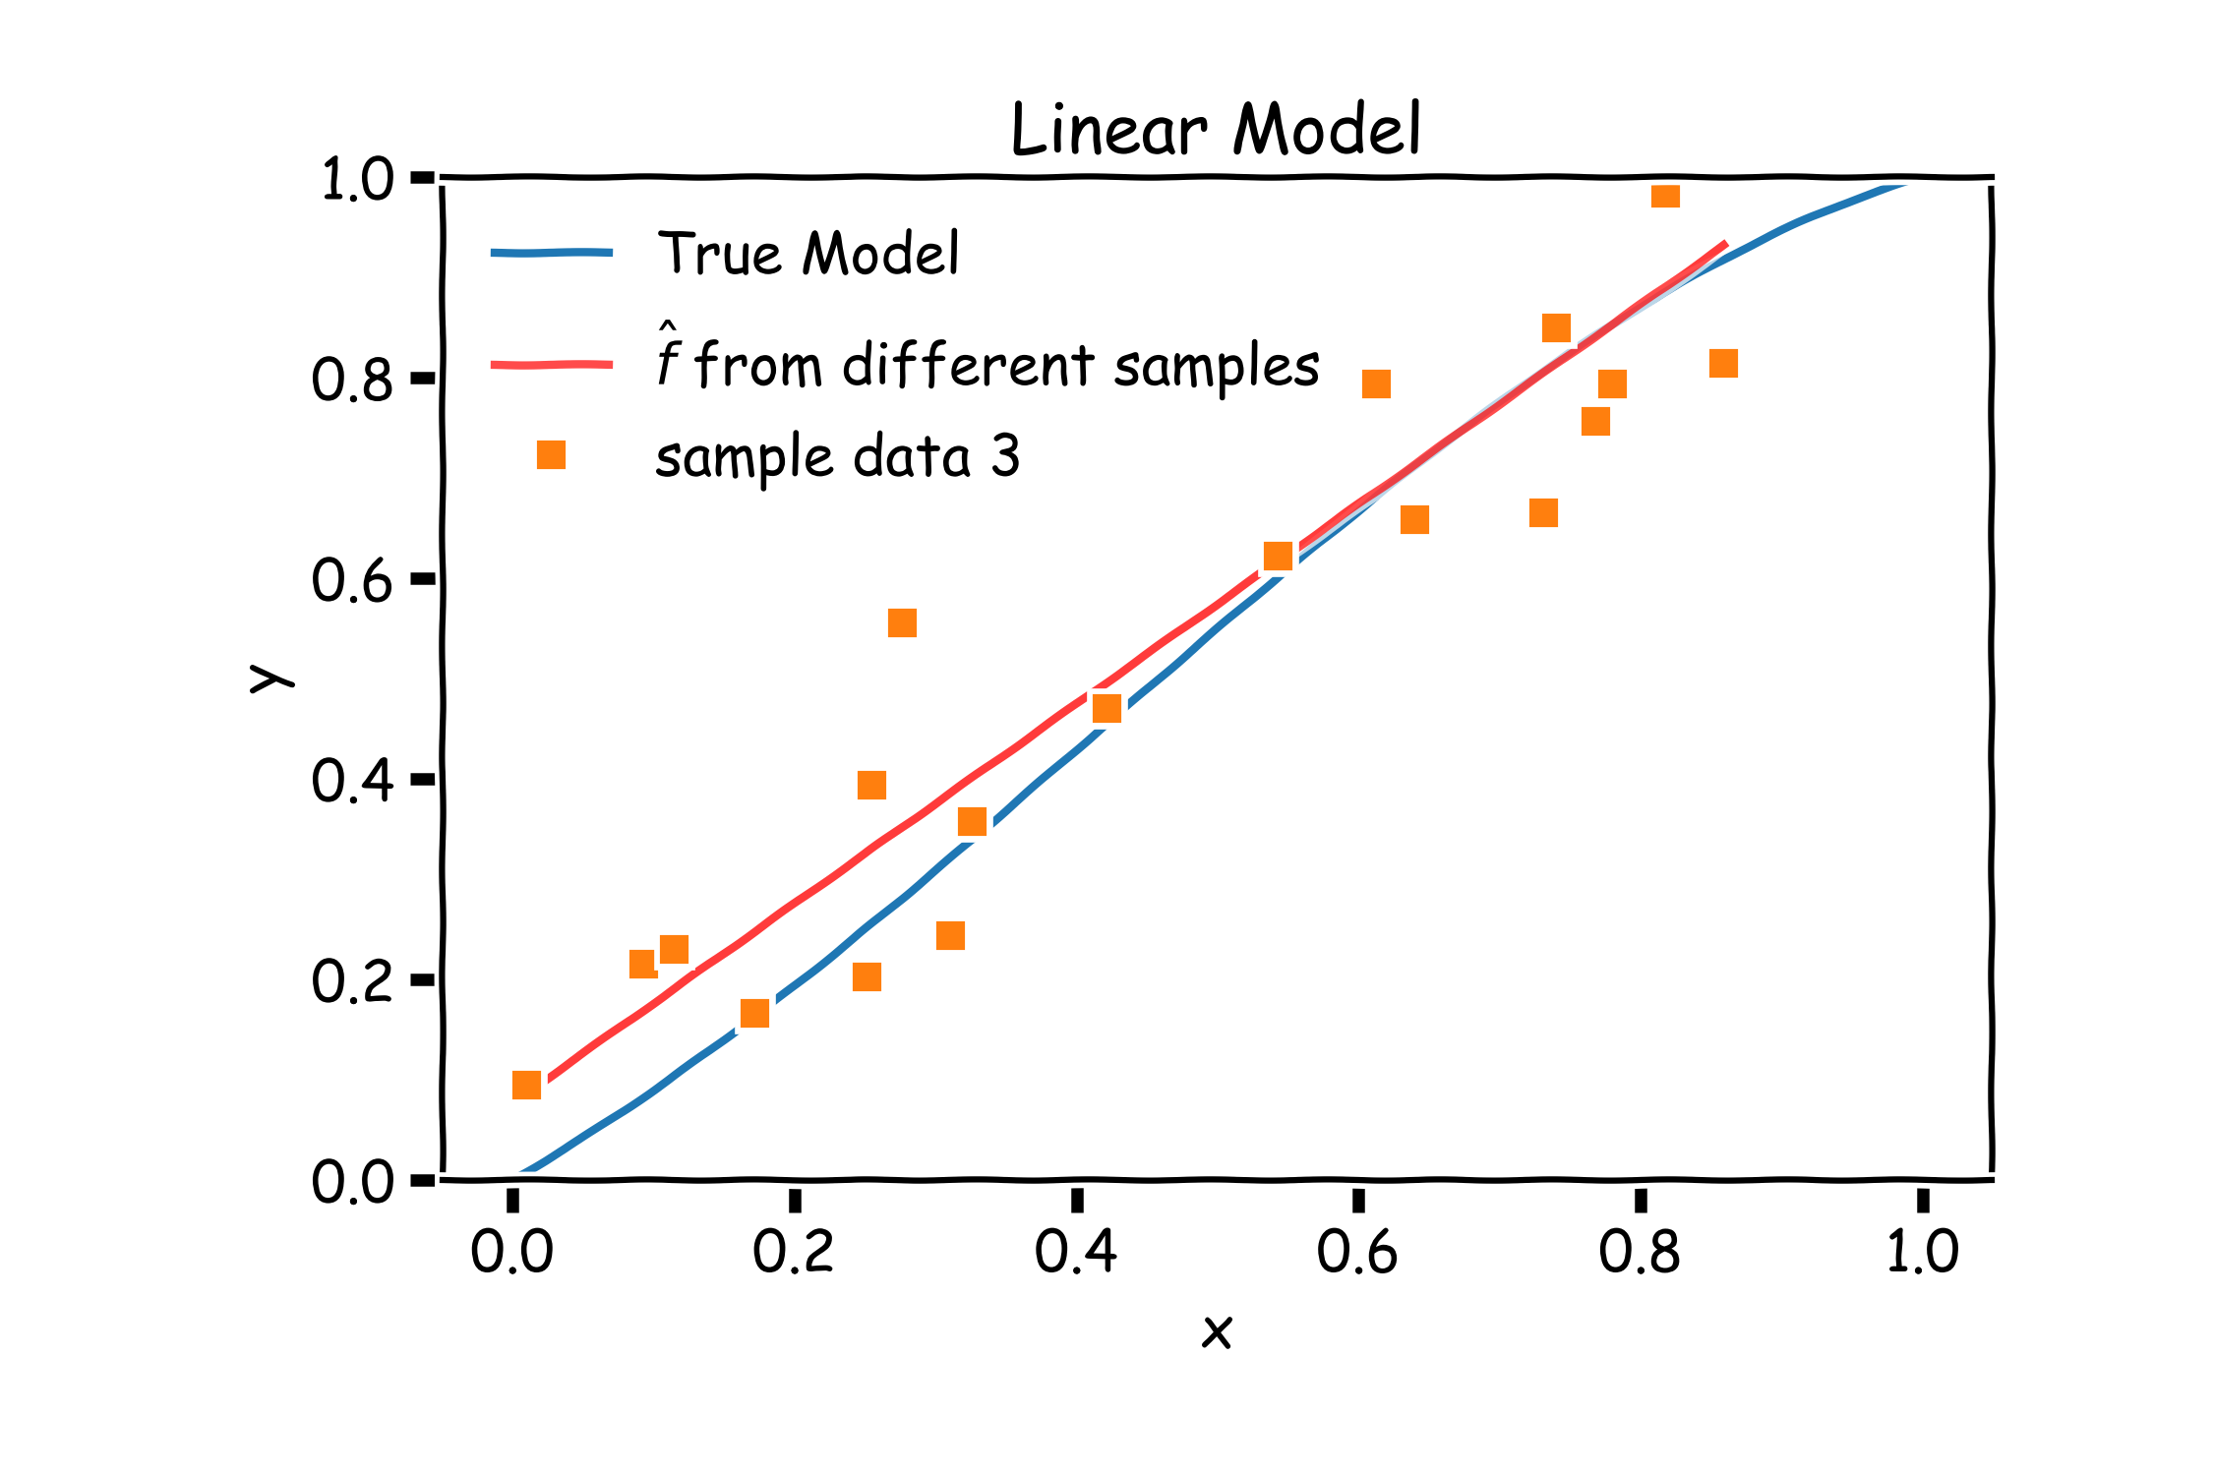
Bias vs Variance

Slide 38
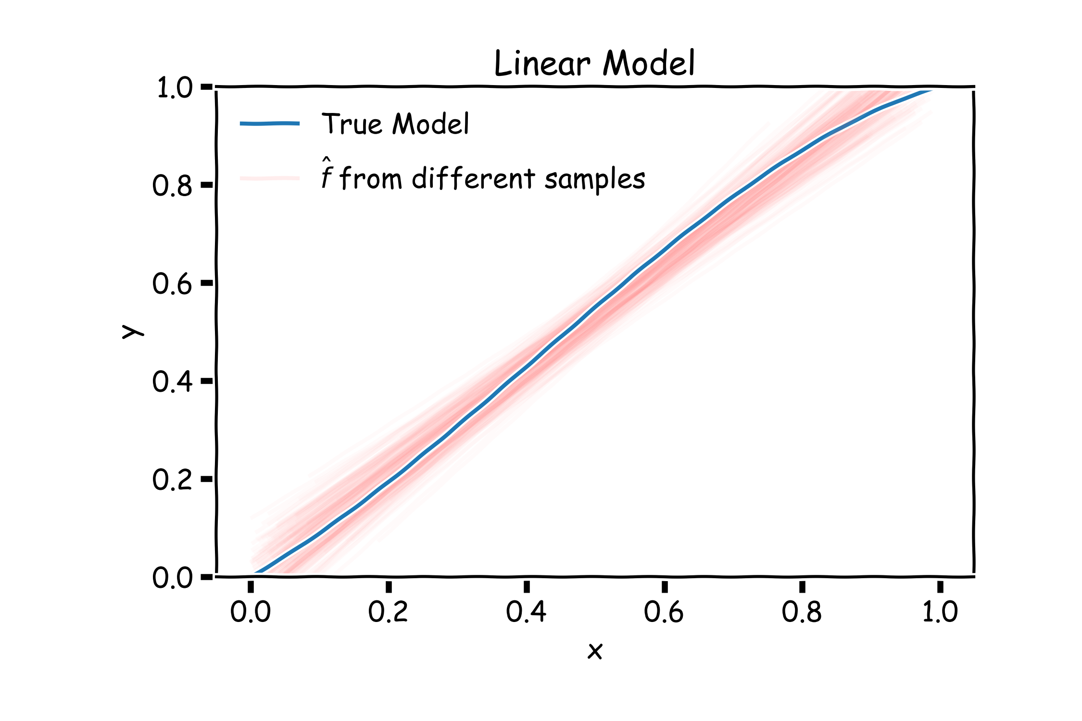
Linear models: 20 data points per line 2000 simulations

Slide 39
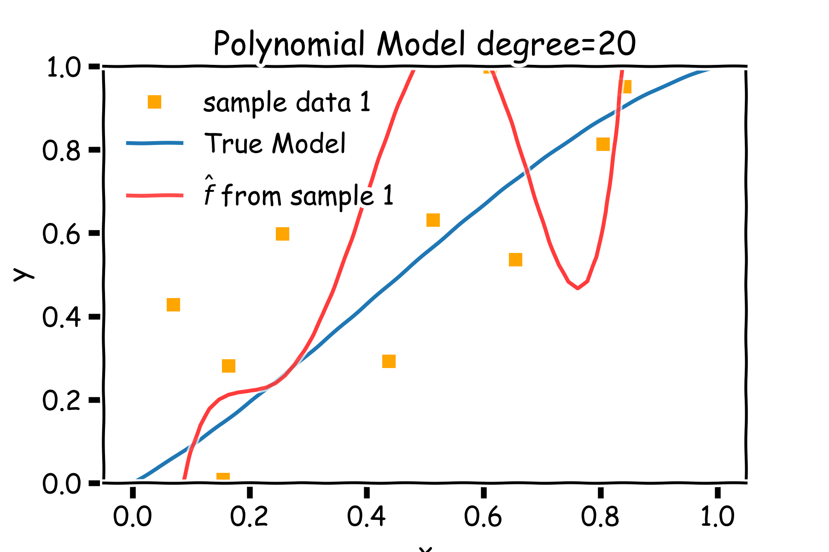
Bias vs Variance

Slide 40
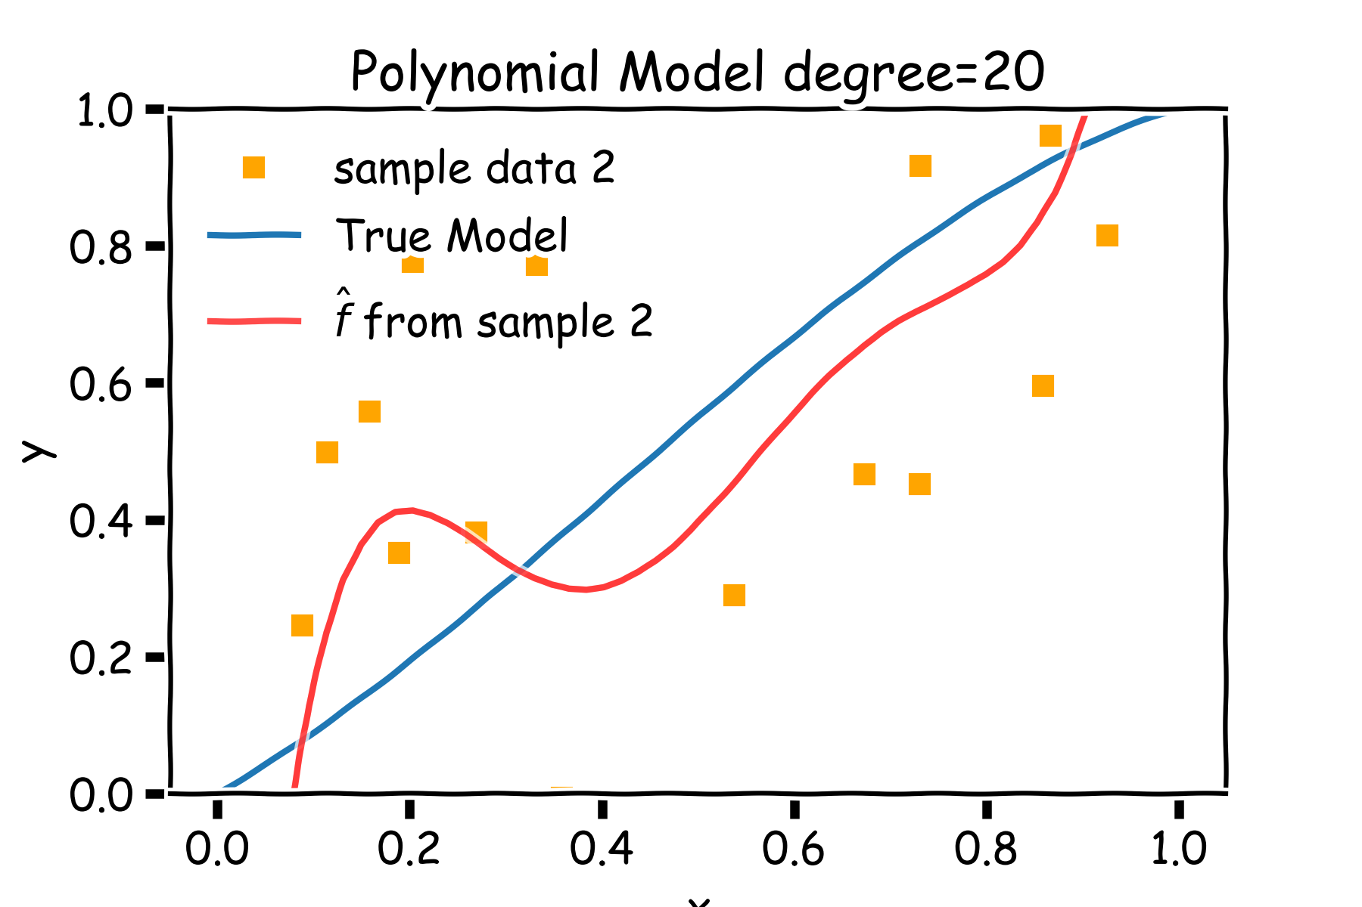
Bias vs Variance

Slide 41
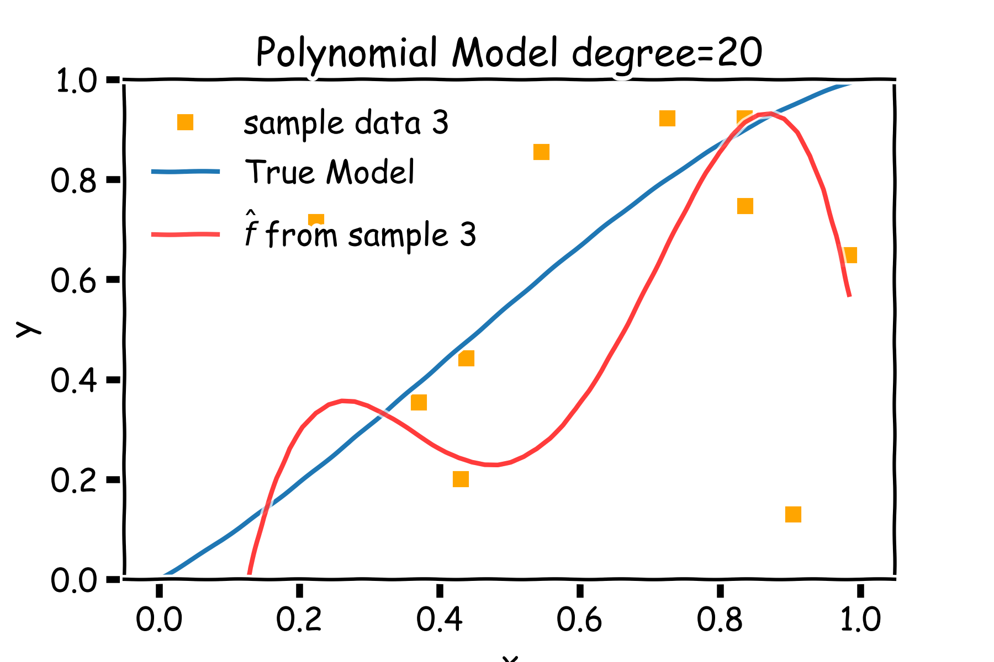
Bias vs Variance

Slide 42
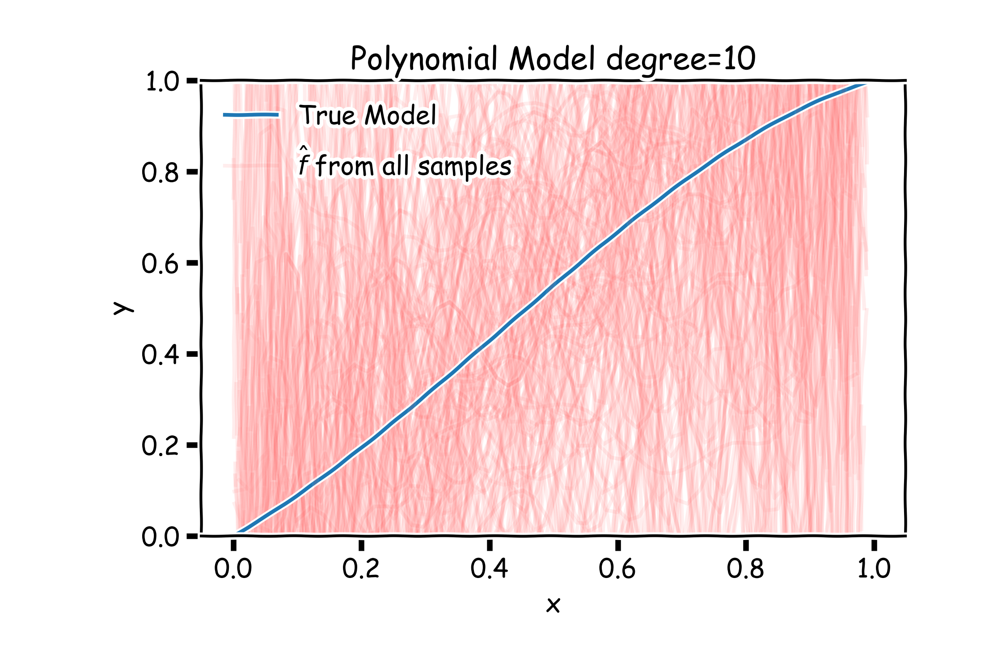
Poly 10 degree models : 20 data points per line 2000 simulations

Slide 43
Bias vs Variance
Left: 2000 best fit straight lines, each fitted on a different 20 point training set.
Right: Best-fit models using degree 10 polynomial

Slide 44
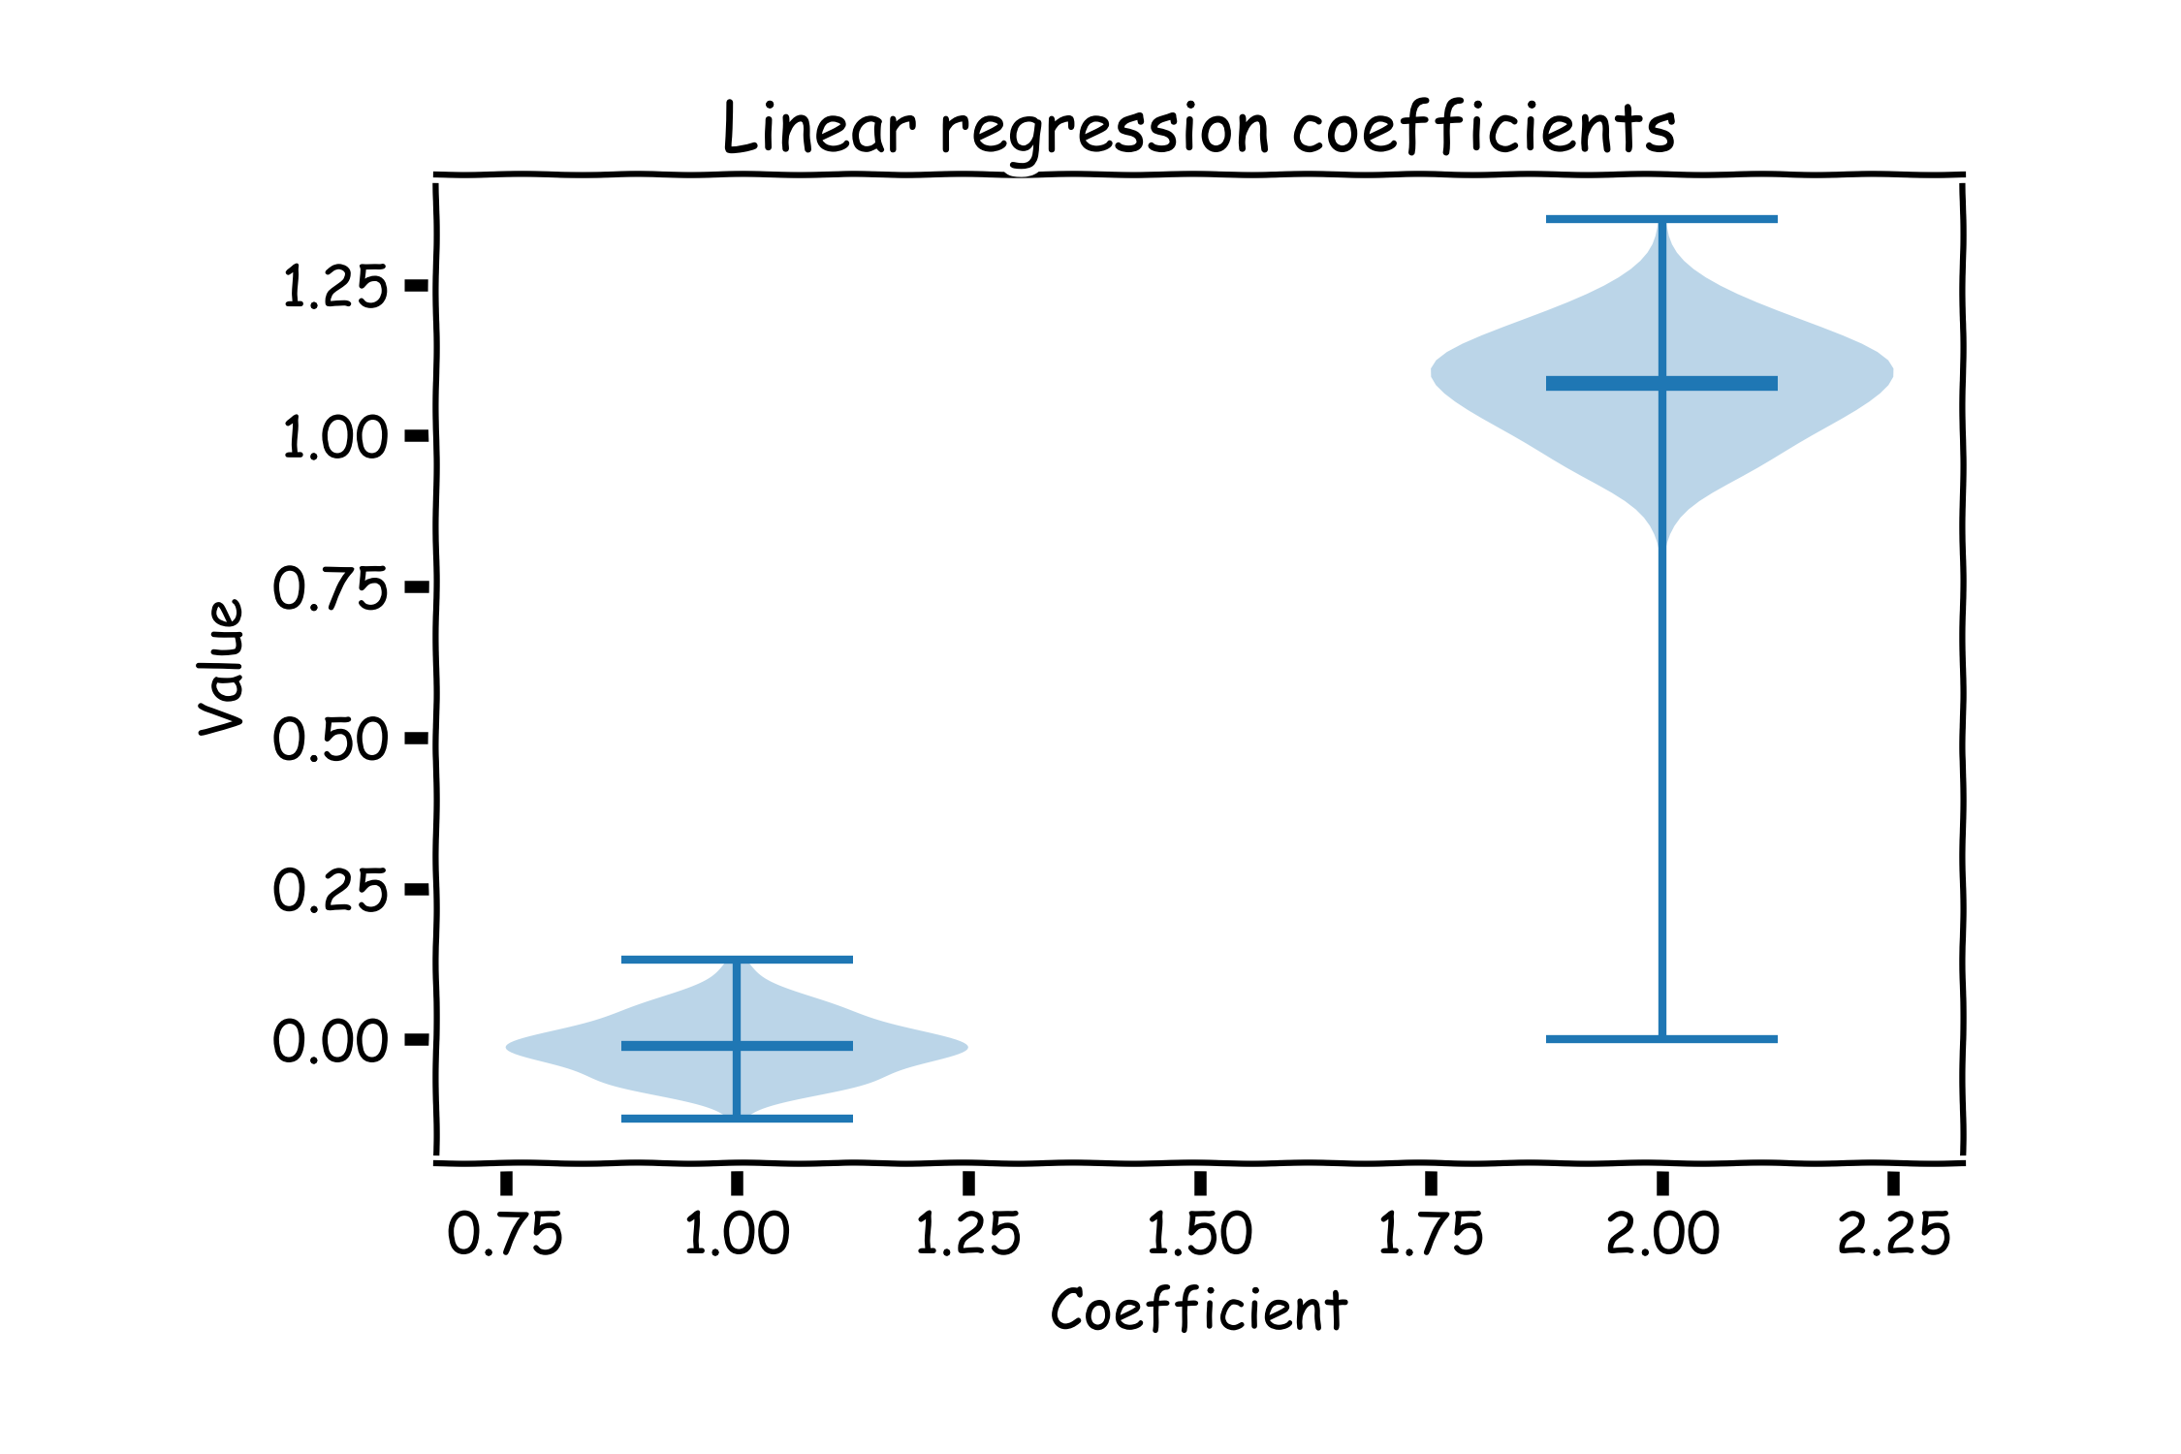
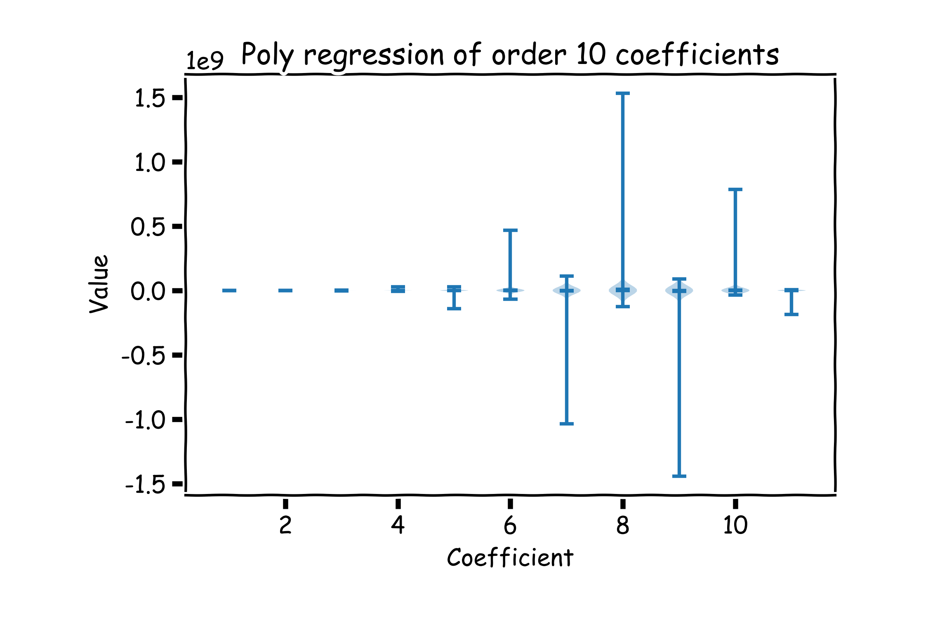
Bias vs Variance
Left: Linear regression coefficients
Right: Poly regression of order 10 coefficients

Slide 45
Regularization: LASSO and Ridge

Slide 46
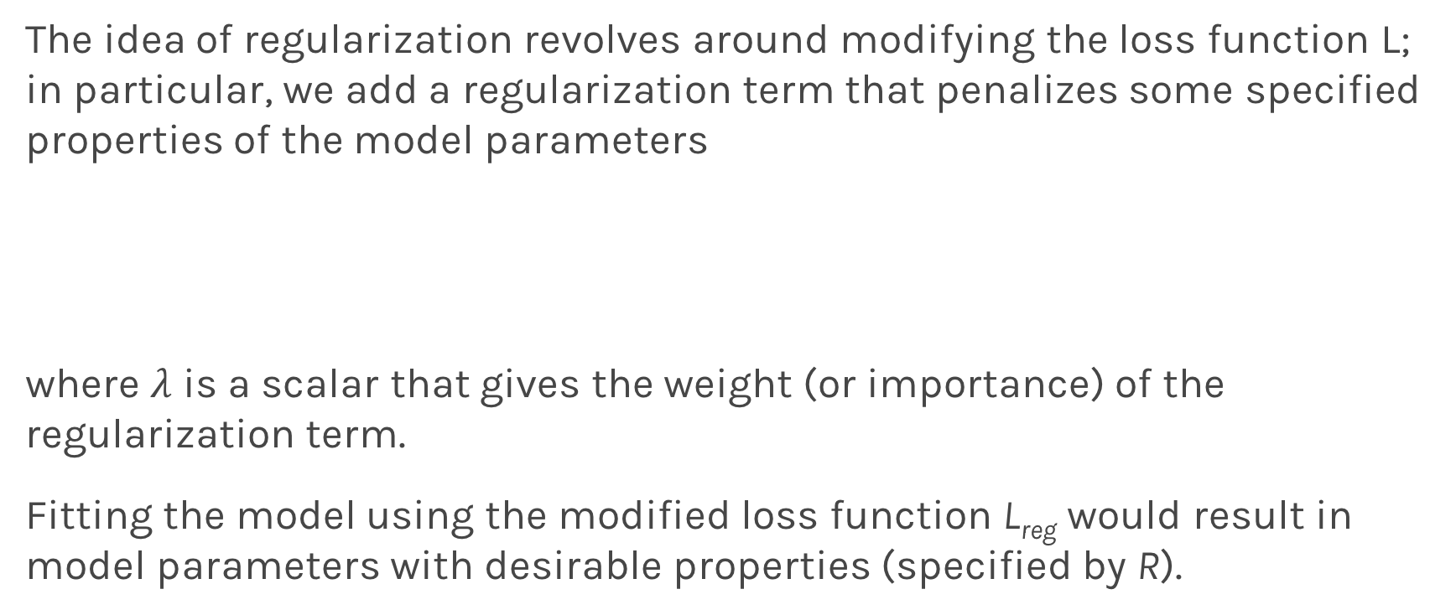
Regularization: An Overview
The idea of regularization revolves around modifying the loss function L; in particular, we add a regularization term that penalizes some specified properties of the model parameters
where $λ$ is a scalar that gives the weight (or importance) of the regularization term.
Fitting the model using the modified loss function L_{reg} would result in model parameters with desirable properties (specified by R).

Slide 47
LASSO Regression
Since we wish to discourage extreme values in model parameter, we need to choose a regularization term that penalizes parameter magnitudes. For our loss function, we will again use MSE.
Together our regularized loss function is:
Note that is the l₁ norm of the vector β

Slide 48
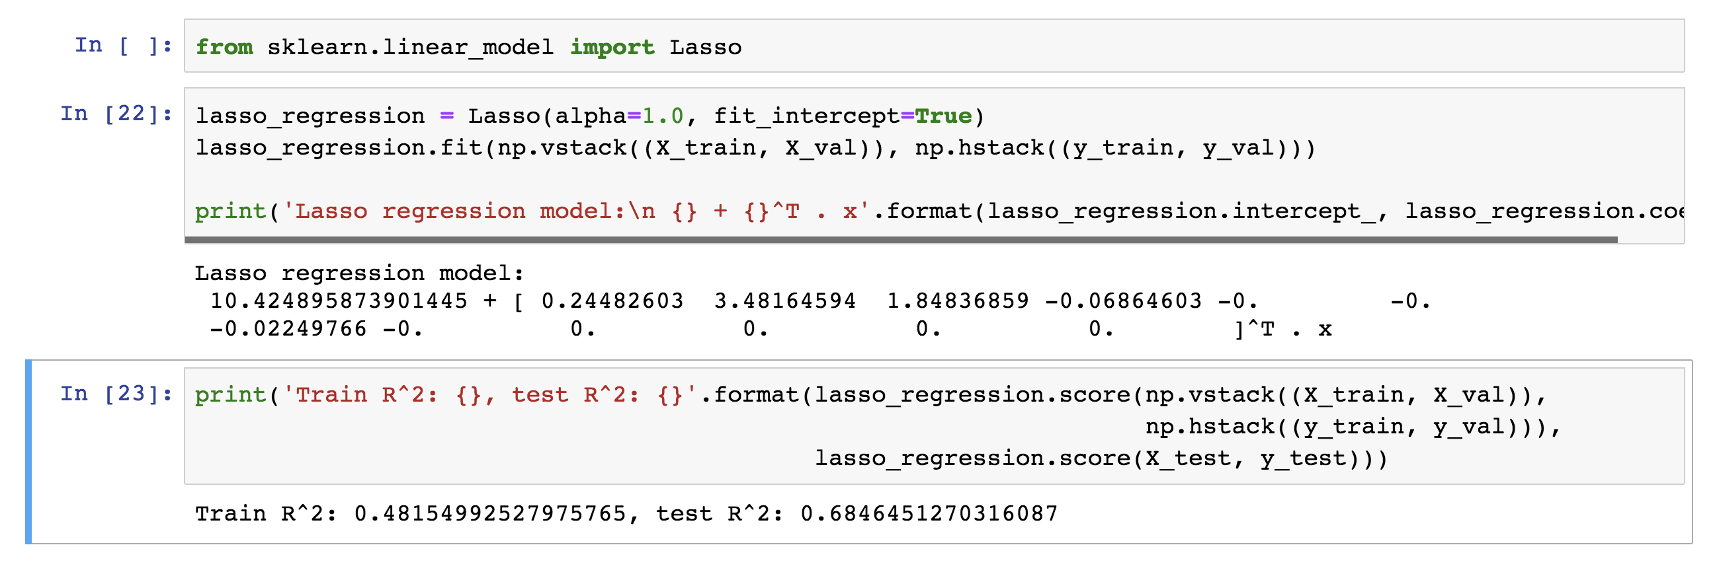
LASSO Regression
Hence, we often say that L_{LASSO} is the loss function for l₁ regularization.
Finding the model parameters β_{LASSO} that minimize the l₁ regularized loss function is called LASSO regression.

Slide 49
Ridge Regression
Alternatively, we can choose a regularization term that penalizes the squares of the parameter magnitudes. Then, our regularized loss function is:
Note that is the l₂ norm of the vector β

Slide 50
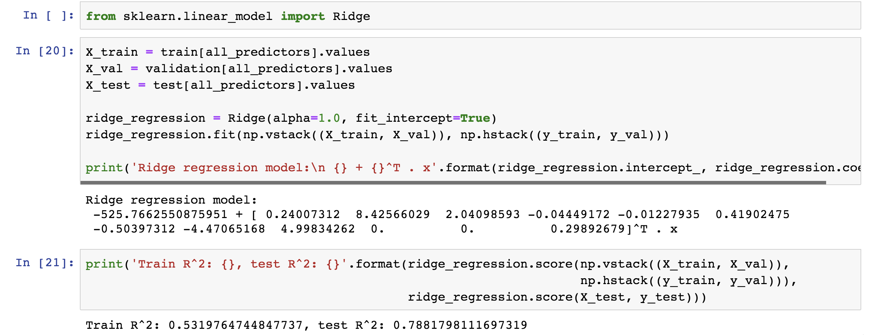
Ridge Regression
Hence, we often say that L_{ridge} is the loss function for l₂ regularization.
Finding the model parameters β_{ridge} that minimize the l₂ regularized loss function is called ridge regression.

Slide 51
Choosing λ
In both ridge and LASSO regression, we see that the larger our choice of the regularization parameter λ, the more heavily we penalize large values in β,
If λ is close to zero, we recover the MSE, i.e. ridge and LASSO regression is just ordinary regression.
If λ is sufficiently large, the MSE term in the regularized loss function will be insignificant and the regularization term will force β_{ridge} and β_{LASSO} to be close to zero.
To avoid ad-hoc choices, we should select λ using cross-validation.

Slide 52
Ridge - Computational complexity
Solution to ridge regression:
The solution of the Ridge/Lasso regression involves three steps
Select λ
Find the minimum of the ridge/Lasso regression cost function (using linear algebra) as with the multiple regression and record the R² on the test set.
Find the λ that gives the largest R²

Slide 53
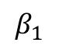
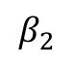
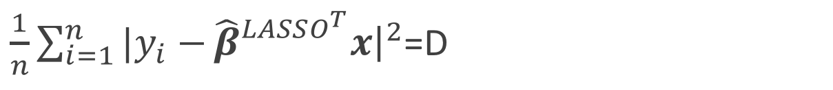
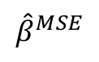
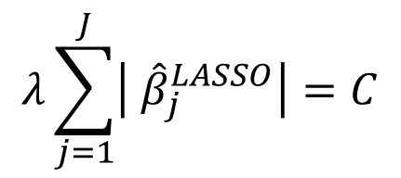
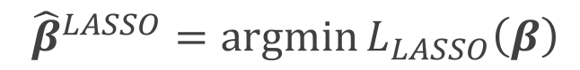
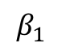
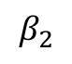
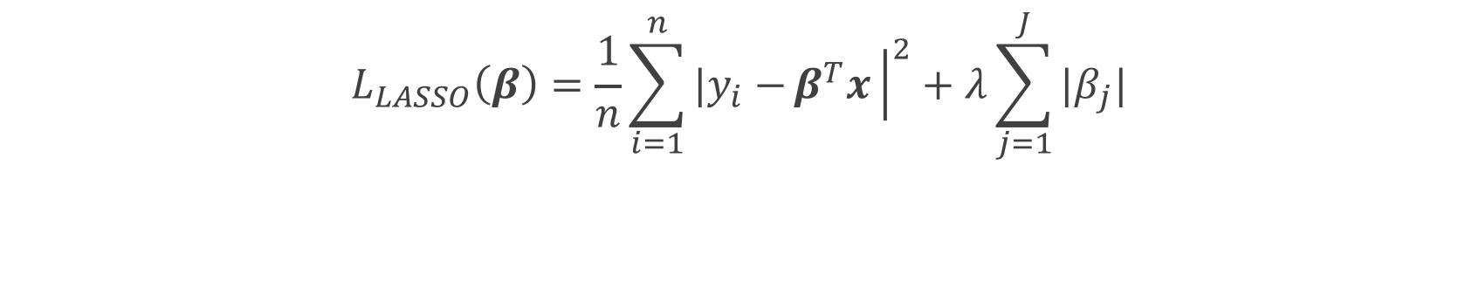
The Geometry of Regularization (LASSO)
$$L_{LASSO}\left(β\right)=\frac{1}{n}\sum_{i=1}^{n}{|y_{i}−}β^{T}x{\left.​\right|}^{2}+λ\sum_{j=1}^{J}{|β_{j}|}$$
$${\hat{β}}^{LASSO}=argmin{L_{LASSO}\left(β\right)}$$
$$λ\sum_{j=1}^{J}{\left| {\hat{β}}_{j}^{LASSO}\right|=C}$$
$\frac{1}{n}\sum_{i=1}^{n}{|y_{i}−}{\hat{β}}_{}^{LASSO^{T}}x{\left.​\right|}^{2}$=D
$$β_{2}$$
$$β_{2}$$
C
$${\hat{β}}^{MSE}$$
MSE=D
C
$$β_{1}$$
$$β_{1}$$

Slide 54
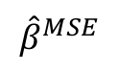
The Geometry of Regularization (LASSO)
$$β_{2}$$
$$β_{2}$$
$$β_{2}$$
$${\hat{β}}^{MSE}$$
MSE=D
C
C
$${\hat{β}}^{MSE}$$
MSE=D
C
C
$$β_{1}$$
$$β_{1}$$
$$β_{1}$$

Slide 55
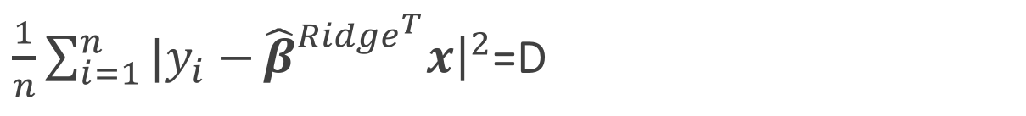
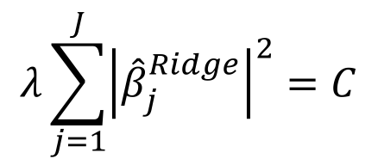
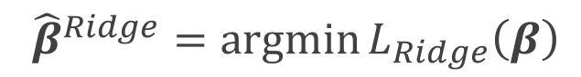
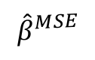
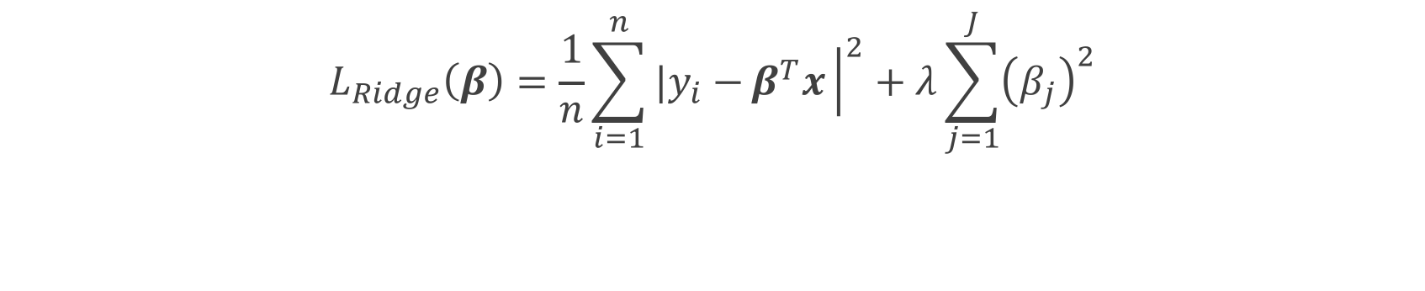
The Geometry of Regularization (Ridge)
$$L_{Ridge}\left(β\right)=\frac{1}{n}\sum_{i=1}^{n}{|y_{i}−}β^{T}x{\left.​\right|}^{2}+λ\sum_{j=1}^{J}{{\left(β_{j}\right)}^{2}}$$
$${\hat{β}}^{Ridge}=argmin{L_{Ridge}\left(β\right)}$$
$$λ\sum_{j=1}^{J}{{\left|{\hat{β}}_{j}^{Ridge}\right|}^{2}=C}$$
$\frac{1}{n}\sum_{i=1}^{n}{|y_{i}−}{\hat{β}}_{}^{{Ridge}^{T}}x{\left.​\right|}^{2}$=D
$$β_{2}$$
$$β_{2}$$
$${\hat{β}}^{MSE}$$
MSE=D
C
$$β_{1}$$
$$β_{1}$$

Slide 56

The Geometry of Regularization (Ridge)
$$β_{2}$$
$${\hat{β}}^{MSE}$$
MSE=D
C
$$β_{1}$$

Slide 57


The Geometry of Regularization
$$β_{2}$$
$$β_{2}$$
$${\hat{β}}^{MSE}$$
MSE=D
$${\hat{β}}^{MSE}$$
MSE=D
C
C
C
$$β_{1}$$
$$β_{1}$$

Slide 58

Ridge regularization with validation only: step by step
split data into $\{{\left\{X,Y\right\}}_{train},{\left\{X,Y\right\}}_{validation},{\left\{X,Y\right\}}_{test}\}$
for $λ in \left\{λ_{min},…λ_{max}\right\}:$
determine the $β$ that minimizes the $L_{ridge}$, ${\hat{β}}_{Ridge}\left(λ\right)={\left(X^{T}X+λI\right)}^{−1}X^{T}Y$ , using the train data.
record $L_{MSE}^{}\left(λ\right)$ using validation data.
select the $λ$that minimizes the loss on the validation data,
$λ_{ridge}={argmin}_{λ} L_{MSE}^{}\left(λ\right)$
Refit the model using both train and validation data, $\{{\left\{X,Y\right\}}_{train},{\left\{X,Y\right\}}_{validation}$ }, resulting to ${\hat{β}}_{ridge}\left(λ_{ridge}\right)$
report MSE or R² on ${\left\{X,Y\right\}}_{test}$ given the ${\hat{β}}_{ridge}\left(λ_{ridge}\right)$

Slide 59

Ridge regularization with validation only: step by step

Slide 60

Lasso regularization with validation only: step by step
split data into $\{{\left\{X,Y\right\}}_{train},{\left\{X,Y\right\}}_{validation},{\left\{X,Y\right\}}_{test}\}$
for $λ in \left\{λ_{min},…λ_{max}\right\}:$
determine the $β$ that minimizes the $L_{lasso}$, ${\hat{β}}_{lasso}\left(λ\right)$, using the train data. This is done using a solver.
record $L_{MSE}^{}\left(λ\right)$ using validation data
select the $λ$that minimizes the loss on the validation data, ${ λ}_{lasso}={argmin}_{λ} L_{MSE}^{}\left(λ\right)$
Refit the model using both train and validation data, $\{{\left\{X,Y\right\}}_{train},{\left\{X,Y\right\}}_{validation}$ }, resulting to ${\hat{β}}_{lasso}\left(λ_{lasso}\right)$
report MSE or R² on ${\left\{X,Y\right\}}_{test}$ given the ${\hat{β}}_{lasso}\left(λ_{lasso}\right)$

Slide 61








Ridge regularization with CV: step by step
 | $$λ_{1}$$ | $$λ_{2}$$ | … | $$λ_{n}$$
$$k_{1}$$
$$k_{2}$$
…
$$k_{n}$$
 | $$λ_{1}$$ | $$λ_{2}$$ | … | $$λ_{n}$$
$$k_{1}$$ | $$L_{11}$$ | $$L_{12}$$ | .. | …
$$k_{2}$$ | $$L_{21}$$ | … | .. | …
… | .. | … | .. | …
$$k_{n}$$ | … | … | … | …
E[] | $${\overline{L}}_{1}$$ | $${\overline{L}}_{2}$$ | … | $${\overline{L}}_{n}$$
 | $$λ_{1}$$ | $$λ_{2}$$ | … | $$λ_{n}$$
$$k_{1}$$
$$k_{2}$$
…
$$k_{n}$$
 | $$λ_{1}$$ | $$λ_{2}$$ | … | $$λ_{n}$$
$$k_{1}$$ | $$L_{11}$$ | $$L_{12}$$ | .. | …
$$k_{2}$$ | $$L_{21}$$ | … | .. | …
… | .. | … | .. | …
$$k_{n}$$ | … | … | … | …
 | $$λ_{1}$$ | $$λ_{2}$$ | … | $$λ_{n}$$
$$k_{1}$$ | $$L_{11}$$
$$k_{2}$$
…
$$k_{n}$$
 | $$λ_{1}$$ | $$λ_{2}$$ | … | $$λ_{n}$$
$$k_{1}$$ | $$L_{11}$$ | $$L_{12}$$ | .. | …
$$k_{2}$$ | $$L_{21}$$ | … | .. | …
… | .. | … | .. | …
$$k_{n}$$ | … | … | … | …
E[] | $${\overline{L}}_{1}$$ | $${\overline{L}}_{2}$$ | … | $${\overline{L}}_{n}$$
 | $$λ_{1}$$ | $$λ_{2}$$ | … | $$λ_{n}$$
$$k_{1}$$
$$k_{2}$$
…
$$k_{n}$$
remove ${\left\{X,Y\right\}}_{test}$ from data
split the rest of data into K folds, $\{{\left\{X,Y\right\}}_{train}^{−k},{\left\{X,Y\right\}}_{val}^{k}\}$
for k in $\left\{1,…,K\right\}$
for $λ in \left\{λ_{0,}…{, λ}_{n}\right\}:$
determine the $β$ that minimizes the $L_{ridge}$, ${\hat{β}}_{ridge}\left(λ,k\right)={\left(X^{T}X+λI\right)}^{−1}X^{T}Y$ , using the train data of the fold, ${\left\{X,Y\right\}}_{train}^{−k}$.
record $L_{MSE}^{}\left(λ,k\right)$ using the validation data of the fold ${\left\{X,Y\right\}}_{val}^{k}$
At this point we have a 2-D matrix, rows are for different k, and columns are for different $λ$ values.
Average the $L_{MSE}(λ,k)$ for each $λ$, ${{\overline{L}}_{MSE}\left(λ\right)}_{}$.
Find the $λ$ that minimizes the ${{\overline{L}}_{MSE}\left(λ\right)}_{}$, resulting to $λ_{ridge}$.
Refit the model using the full training data, $\{{\left\{X,Y\right\}}_{train},{\left\{X,Y\right\}}_{val}$ }, resulting to ${\hat{β} }_{ridge}\left(λ_{ridge}\right)$
report MSE or R² on ${\left\{X,Y\right\}}_{test}$ given the ${\hat{β}}_{ridge}\left(λ_{ridge}\right)$

Slide 62

Ridge regularization with validation only: step by step

Slide 63
Variable Selection as Regularization
Since LASSO regression tend to produce zero estimates for a number of model parameters - we say that LASSO solutions are sparse - we consider LASSO to be a method for variable selection.
Many prefer using LASSO for variable selection (as well as for suppressing extreme parameter values) rather than stepwise selection, as LASSO avoids the statistic problems that arises in stepwise selection.
Question: What are the pros and cons of the two approaches?

Slide 64
Behind Ordinary Least Squares, AIC, BIC

Slide 65

Likelihood Functions
Recall that our statistical model for linear regression in matrix notation is:
It is standard to suppose that $ε\sim N\left(0,σ^{2}\right).$In fact, in many analyses we have been making this assumption. Then,
Question: Can you see why?
Note that $N\left(xβ,σ^{2}\right)$ is naturally a function of the model parameters $β$, since the data is fixed.

Slide 66

Likelihood Functions
We call:
the likelihood function, as it gives the likelihood of the observed data for a chosen model $β$.

Slide 67

Maximum Likelihood Estimators
Once we have a likelihood function, $ℒ(β)$, we have strong incentive to seek values of to maximize $ℒ$.
Can you see why?
The model parameters that maximizes $ℒ$ are called maximum likelihood estimators (MLE) and are denoted:
The model constructed with MLE parameters assigns the highest likelihood to the observed data.

Slide 68

Maximum Likelihood Estimators
But how does one maximize a likelihood function?
Fix a set of n observations of J predictors, X, and a set of corresponding response values, Y; consider a linear model $Y=Xβ+ε$.
If we assume that $ε∼Ν(0,σ^{2})$ then the likelihood for each observation is
and the likelihood for the entire set of data is

Slide 69

Maximum Likelihood Estimators
Through some algebra, we can show that maximizing $ℒ(β)$, is equivalent to minimizing MSE:
Minimizing MSE or RSS is called ordinary least squares.

